Slide 1
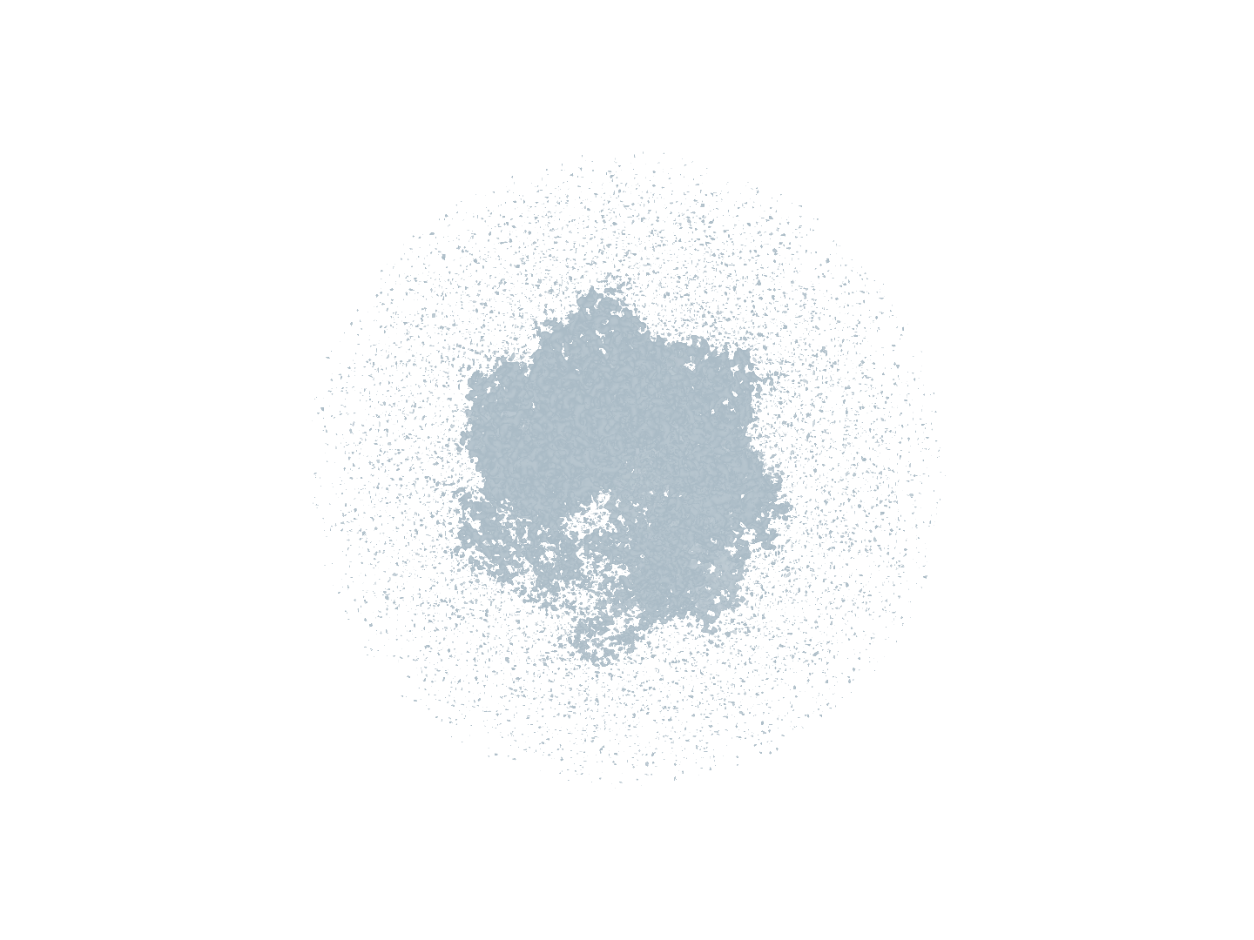
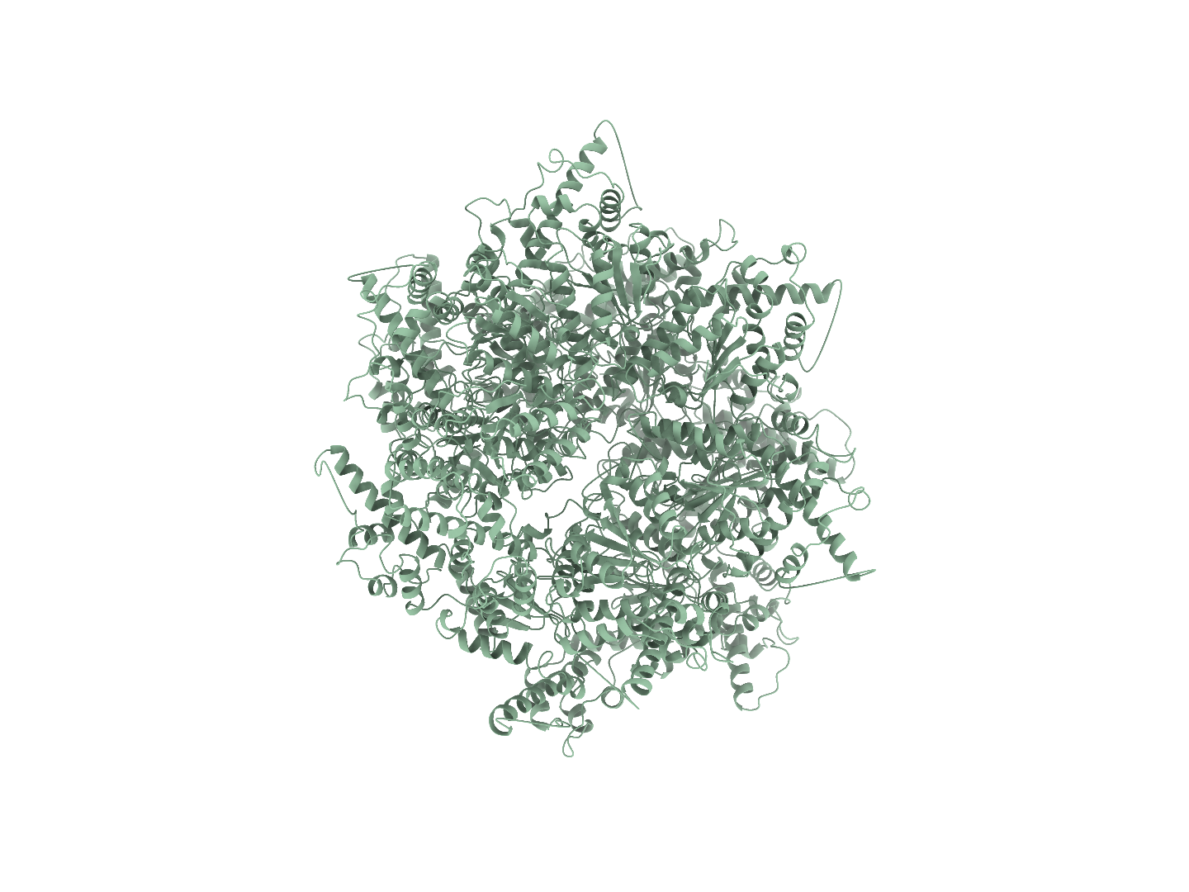
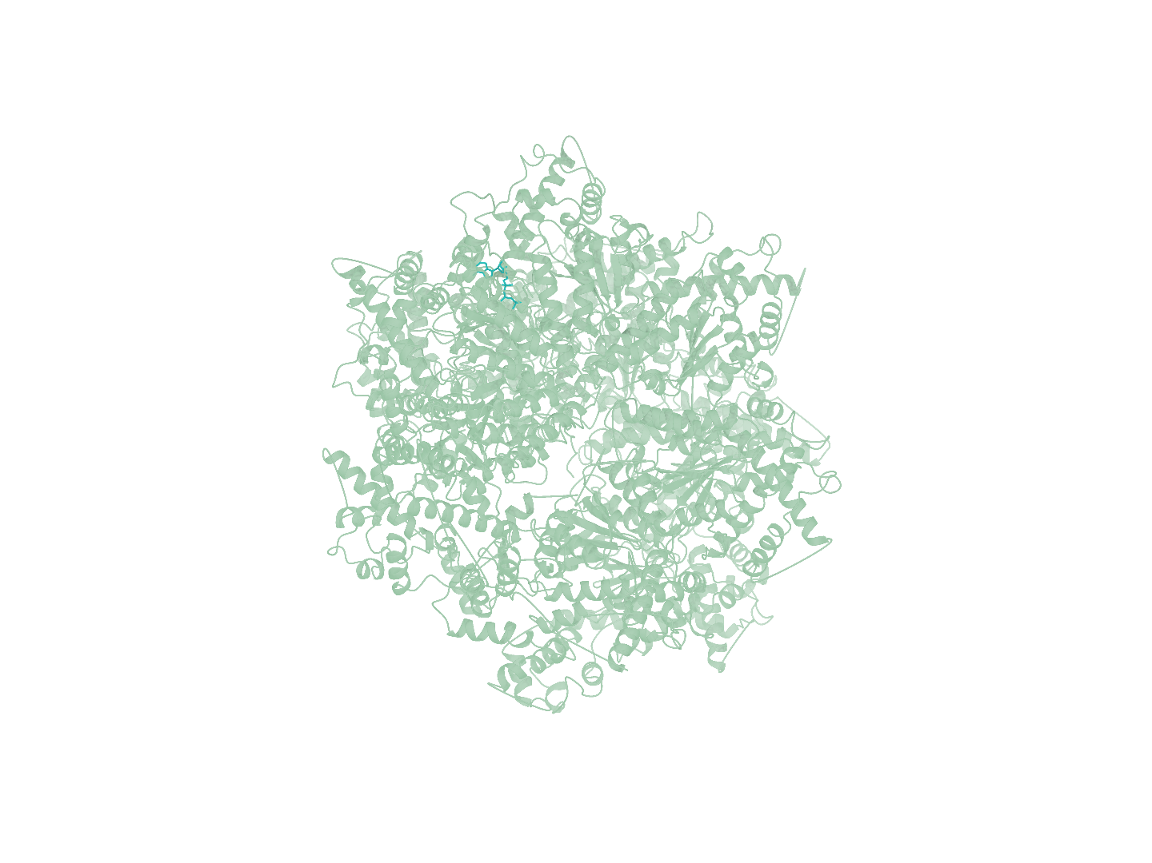
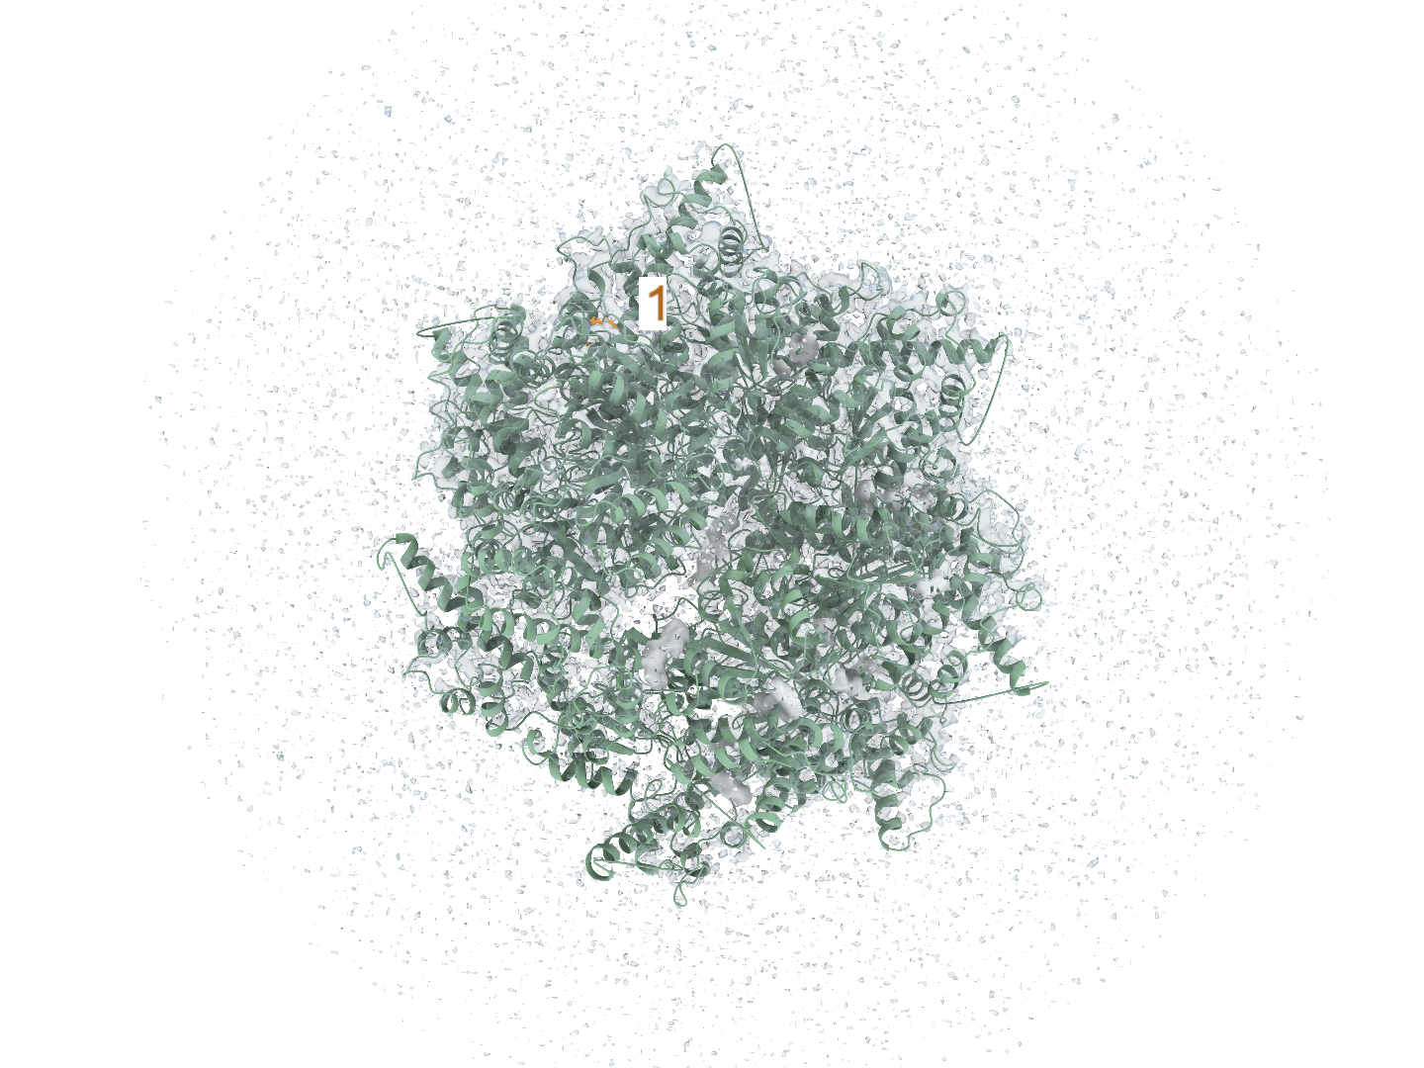
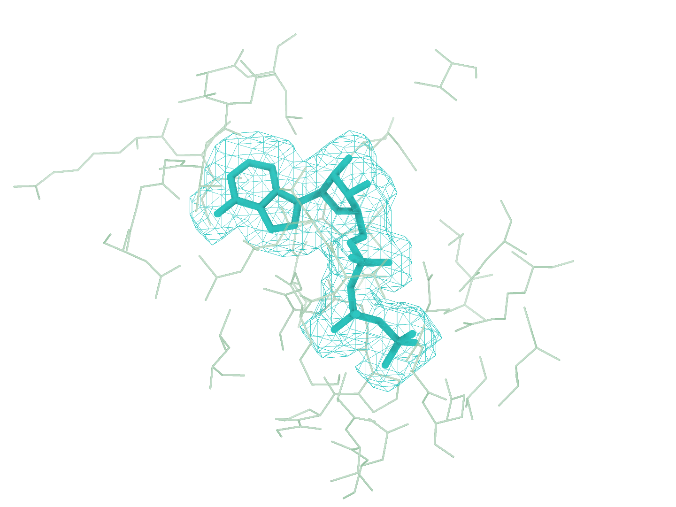
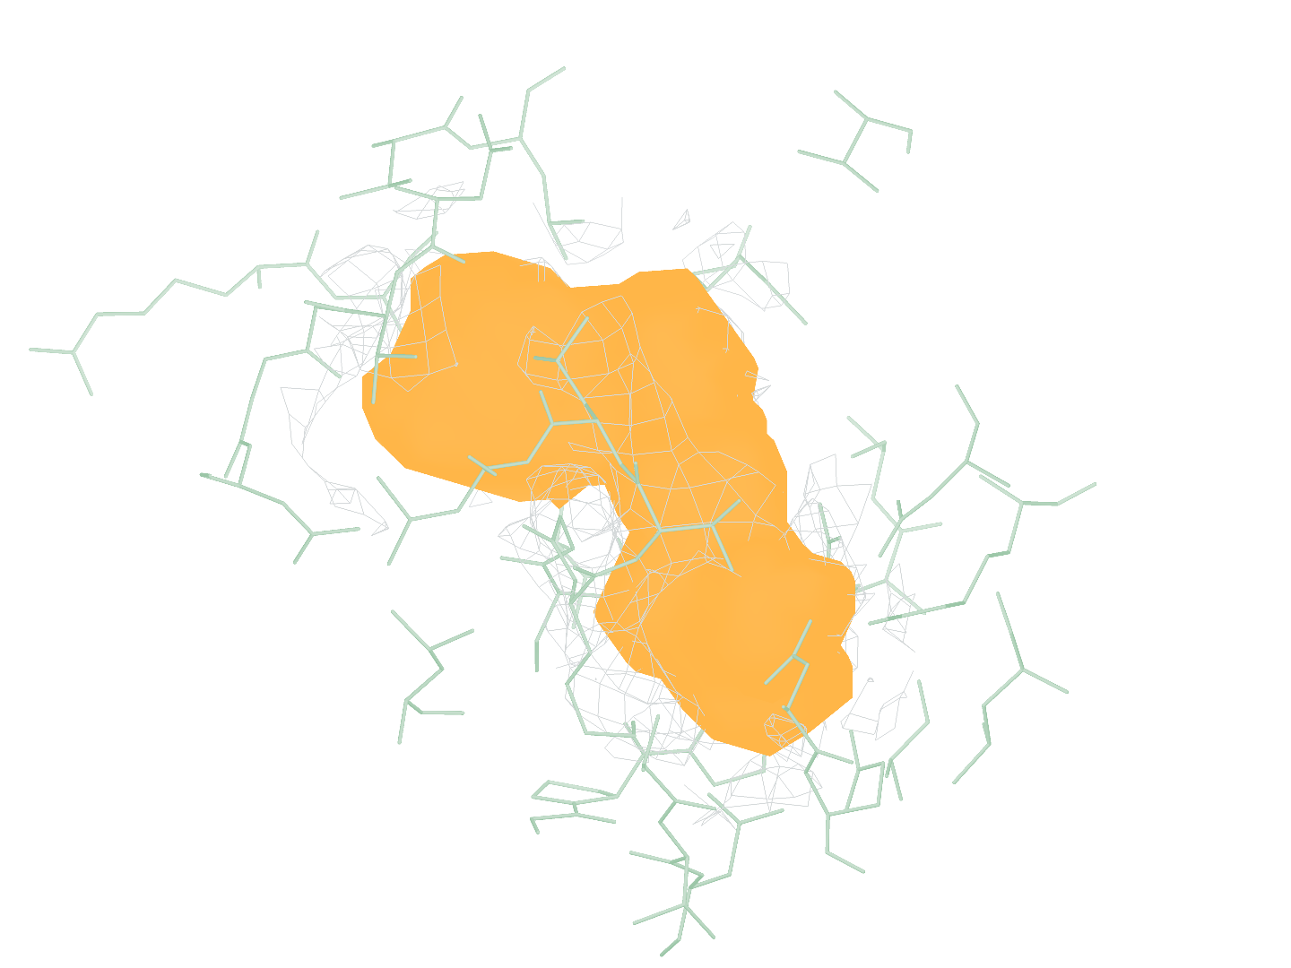
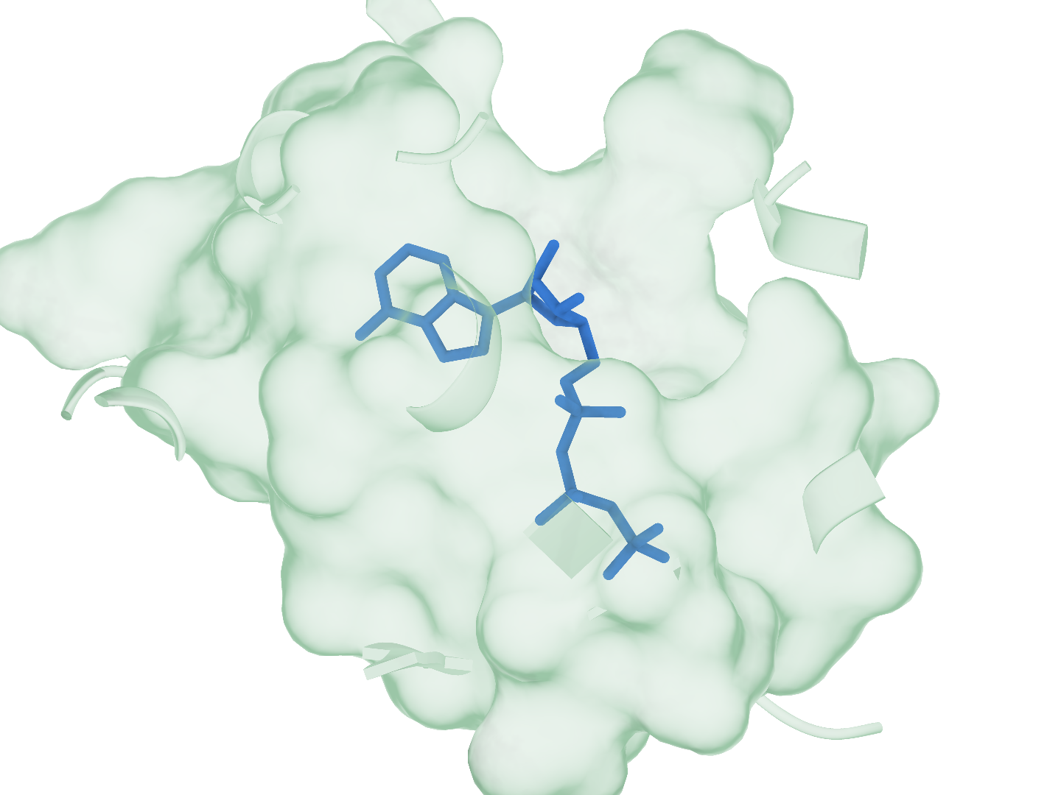
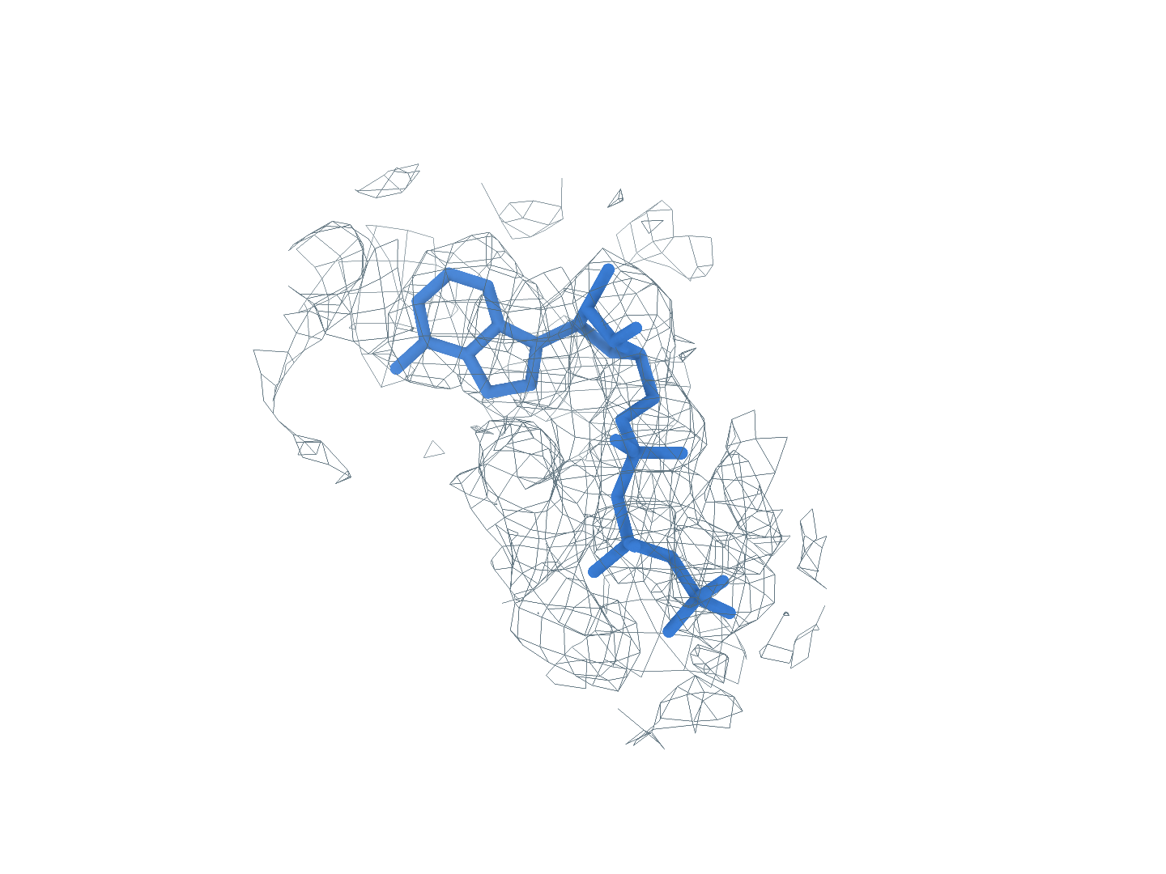
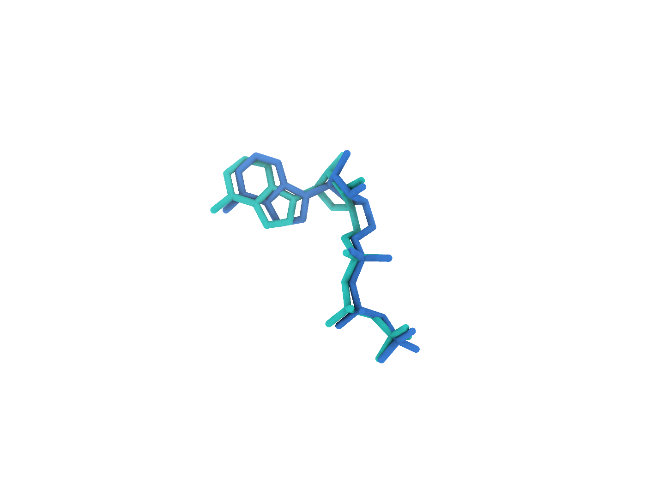
9BJJ ATP (B:901)
The first-ranked site completes identity matching and pose reconstruction
0
Input
Experimental map and CA2 receptor
a
Full experimental map
b
Full CA2 receptor
c
GT receptor (reference)
1
Find
Ranked density regions, site 1 uses charged attempt 1
d
Global candidates
e
GT neighborhood
f
Find prediction
Rank 1: target ligand
All 15 predicted blobs
2
Match
RDKit structures of every supplied SMILES identity
g
1 ATP
2 Identity2
3 Identity3
Matched identity
Eligible small molecule
Outside Stage3 scope
3
Build
local_cov-C self-ranking Top-1, one pose in three views
h
Receptor surface
i
Experimental density
j
Deposited pose overlay
Heavy-atom RMSD 0.80 Å Clash 0 50 poses, 100 steps
Receptor
Density
Target blob
Predicted pose
Deposited pose
Notes:
图 12｜9BJJ 的完整重建流程。首位 ATP(B:901) 依次完成区域检出、身份匹配和构象重建。 a–c，完整实验密度、CryoAtom2 受体及 GT 受体参考。d，全部 15 个预测 blob 的全局分布；e、f，GT 邻域与 Find 局部对照，每对朝向和尺度一致。g，原顺序的全部 3 个 SMILES 身份，2 个合格小分子参与匹配，蓝框标出精确匹配项。h–j，同一 local_cov-C 自评分首位姿态的受体、密度和沉积构象叠加视图，重原子 RMSD 0.80 Å。受体绿色，密度灰色，目标 blob 橙色，背景灰紫色，预测构象蓝色，沉积构象青绿色。所示目标位点生成 50 个姿态，每姿态 100 步采样；GT 仅供参考及最终评价。

Slide 2

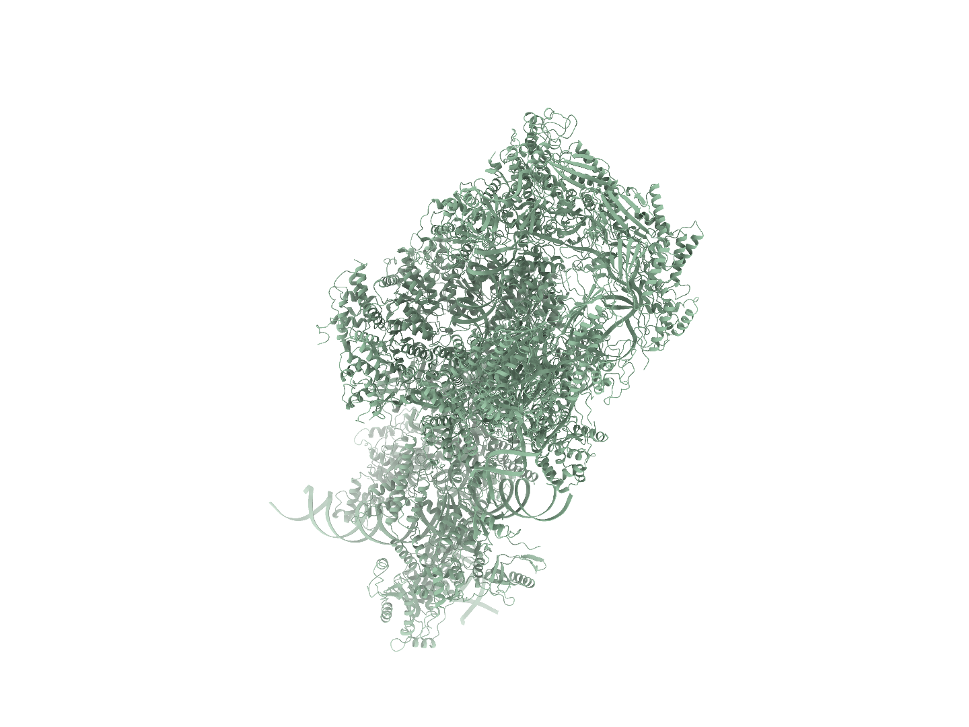
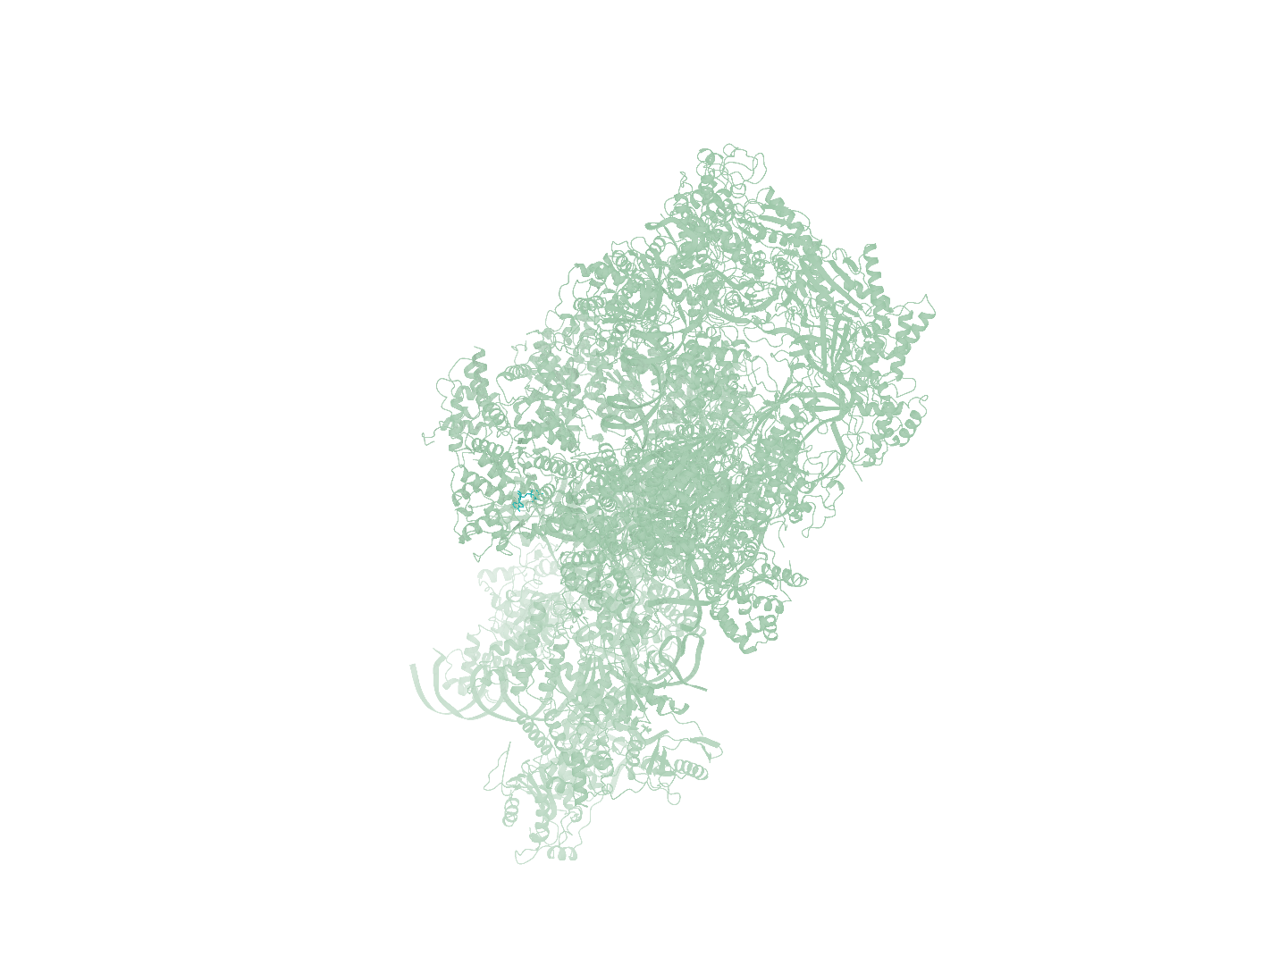
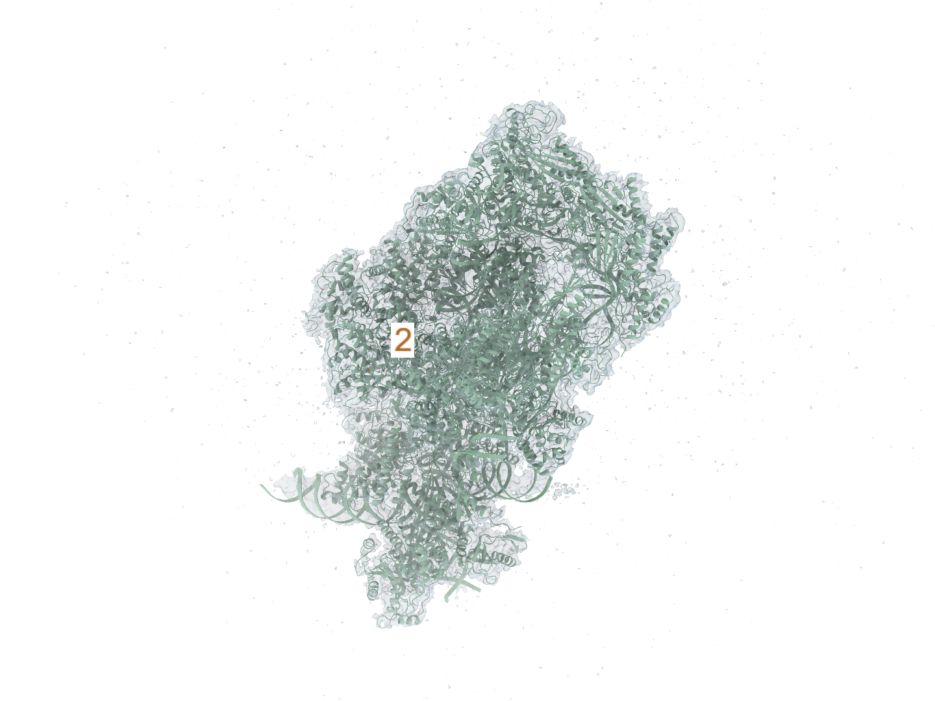
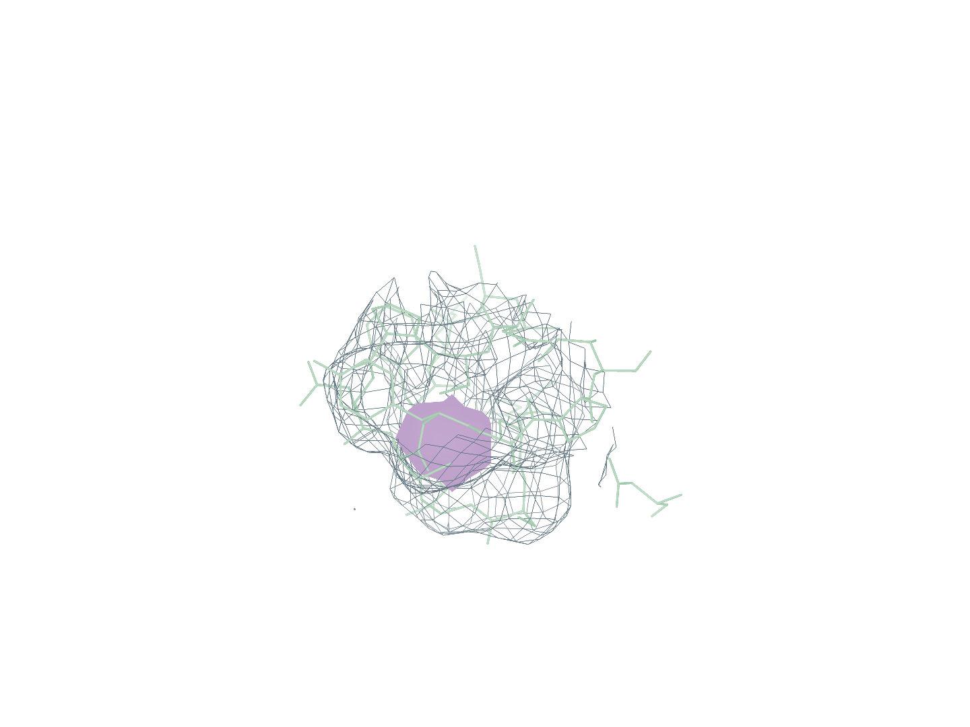
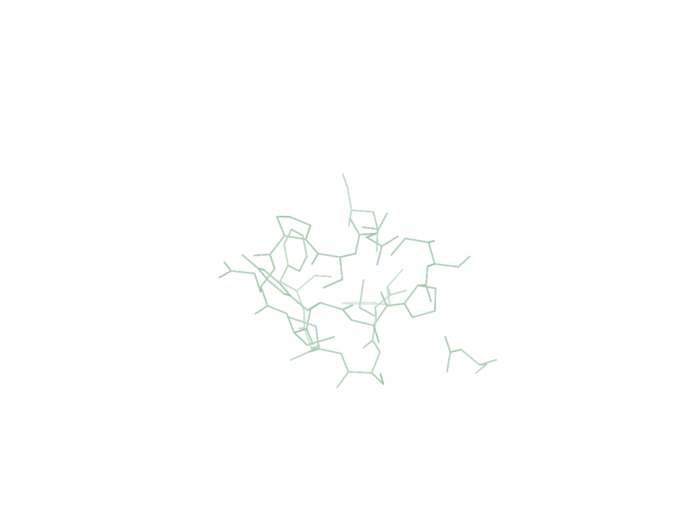
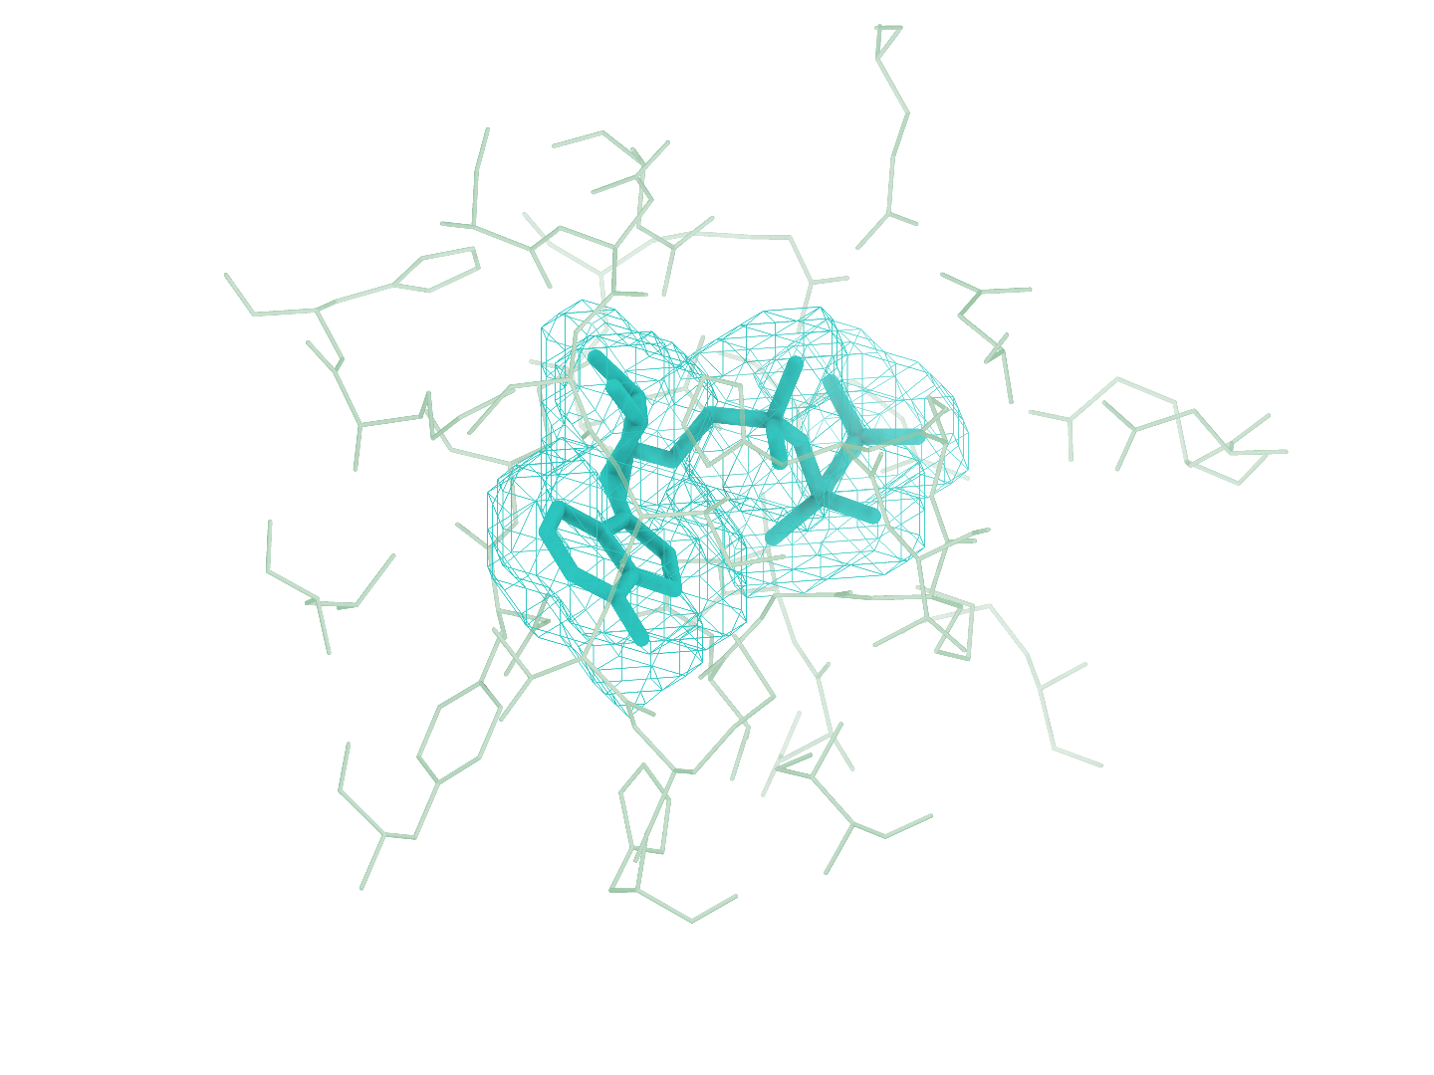
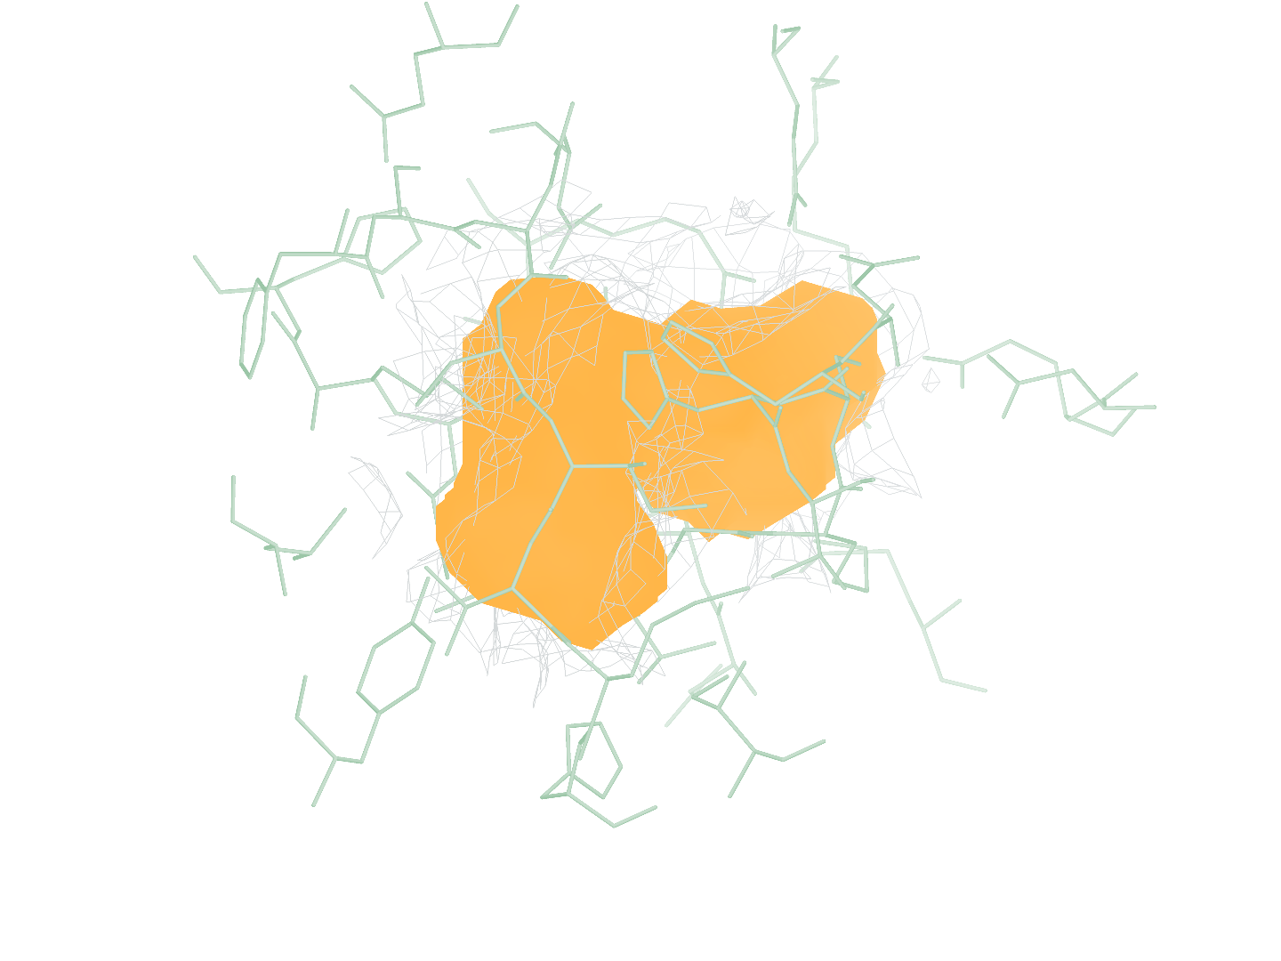
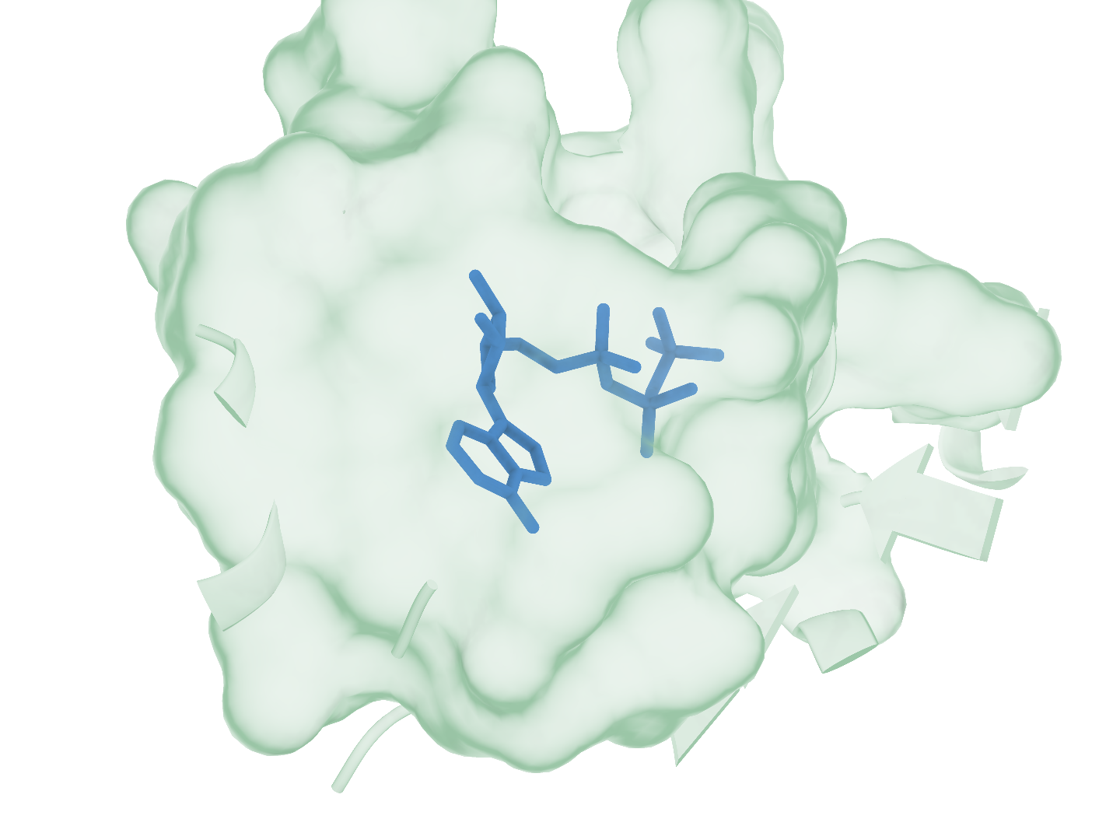
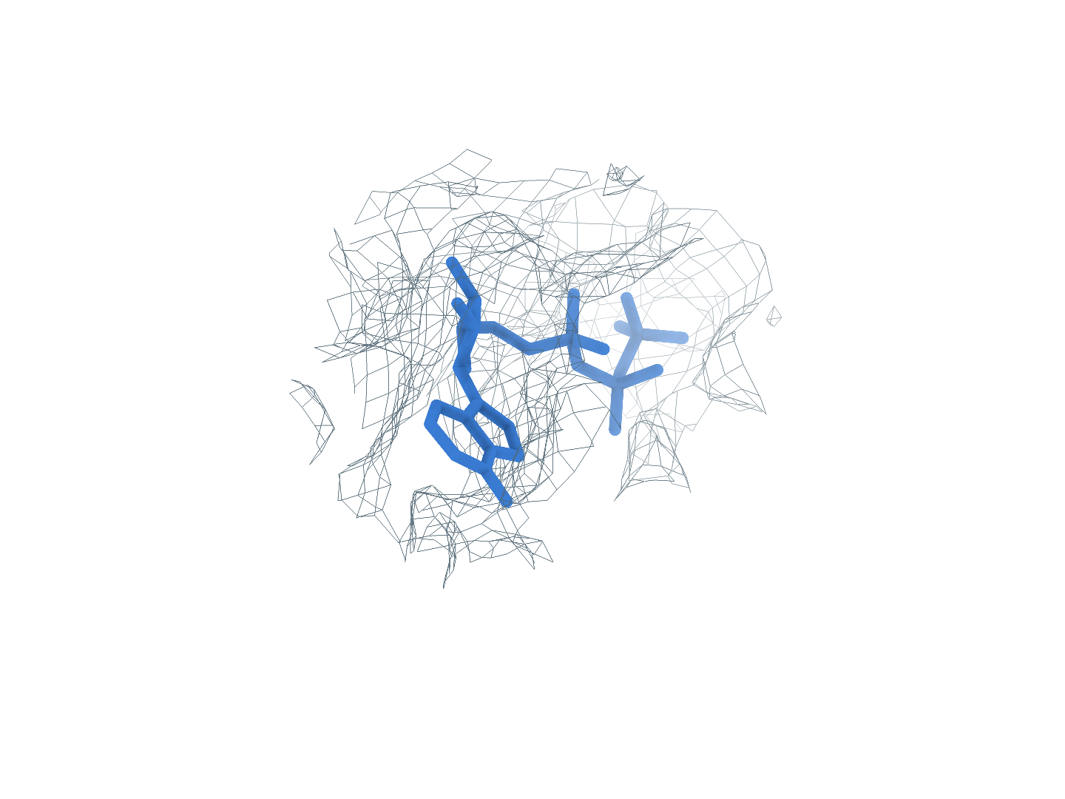
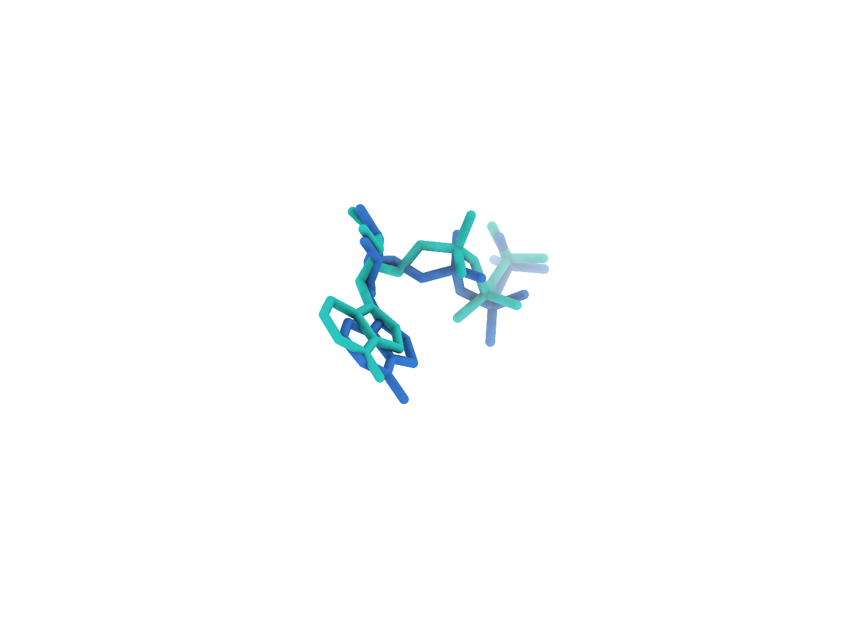






30GA ATP (N:401)
Background at rank 1, successful reconstruction at rank 2
0
Input
Using the CryoAtom2 to model receptor by CryoEM map as the two original inputs
a
Full experimental map
b
Full CA2 receptor
c
GT receptor (reference)
1
Find
Locating ligand area in the complete density map
d
Global candidates
e
GT neighborhood
f
Find prediction
Rank 1: background, one attempt
Rank 2: target ligand, next attempt
2
Match
Matching the blob with SMILES in the same PDB
g
1 ATP
2 Identity2
Matched identity
3
Build
Generating the Top-1 pose using PocketXmol-tuned.
h
Receptor surface
i
Experimental density
j
Deposited pose overlay
RMSD 1.04 Å
Receptor
Density
Target blob
Predicted pose
Deposited pose
Notes:
图 13｜30GA 的完整重建流程。首位背景消耗一次尝试，未进入 Match 或 Build；第二位 ATP(N:401) 完成重建。 a–c，完整实验密度、CryoAtom2 受体及 GT 受体参考。d，全部 19 个预测 blob 的全局分布；e、f，GT 邻域与 Find 局部对照，每对朝向和尺度一致。g，原顺序的全部 2 个 SMILES 身份，1 个合格小分子参与匹配，蓝框标出精确匹配项。h–j，同一 local_cov-C 自评分首位姿态的受体、密度和沉积构象叠加视图，重原子 RMSD 1.04 Å。受体绿色，密度灰色，目标 blob 橙色，背景灰紫色，预测构象蓝色，沉积构象青绿色。所示目标位点生成 50 个姿态，每姿态 100 步采样；GT 仅供参考及最终评价。

Slide 3

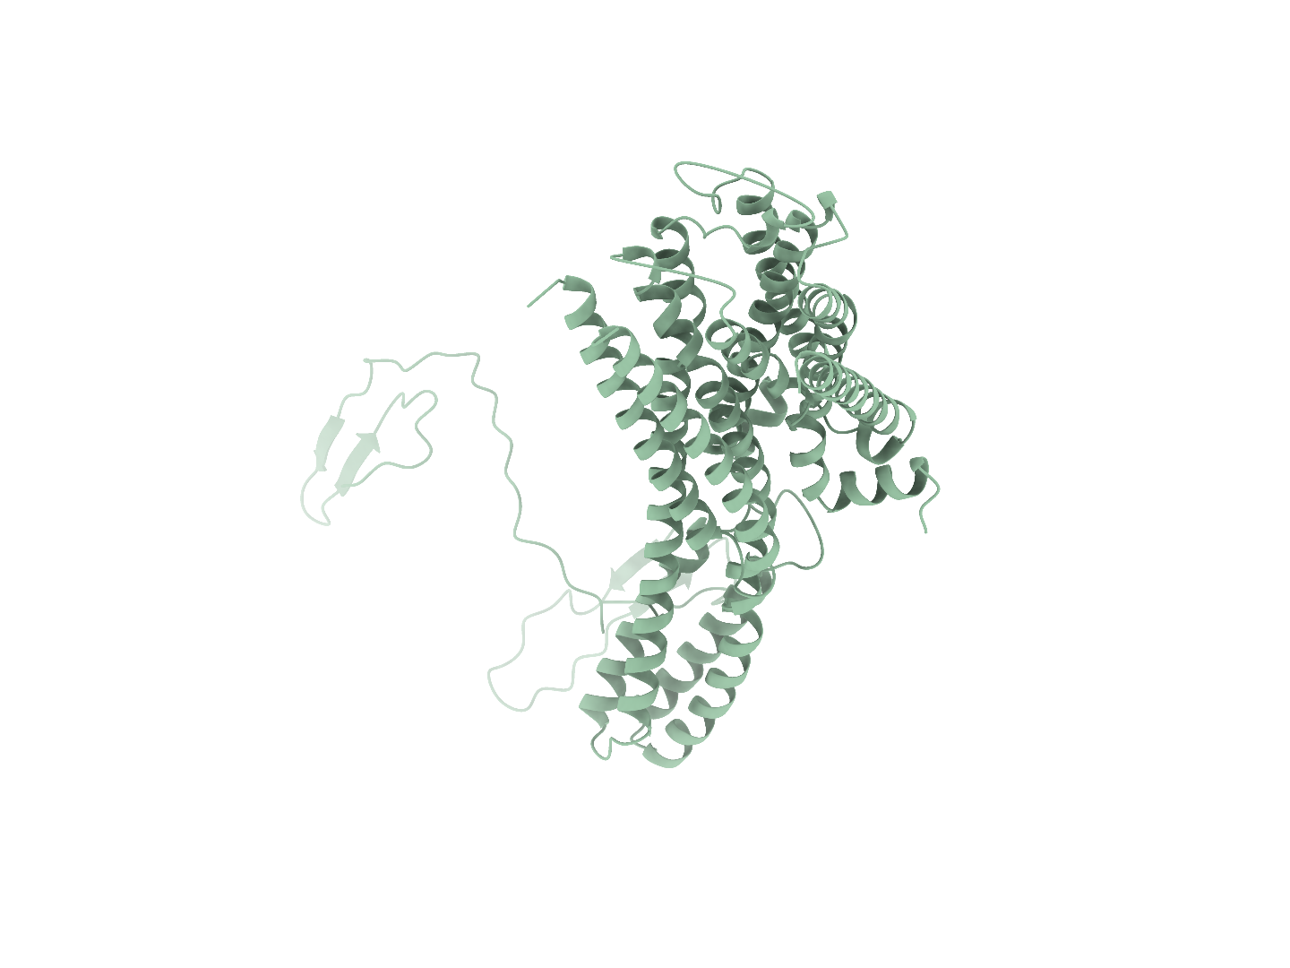
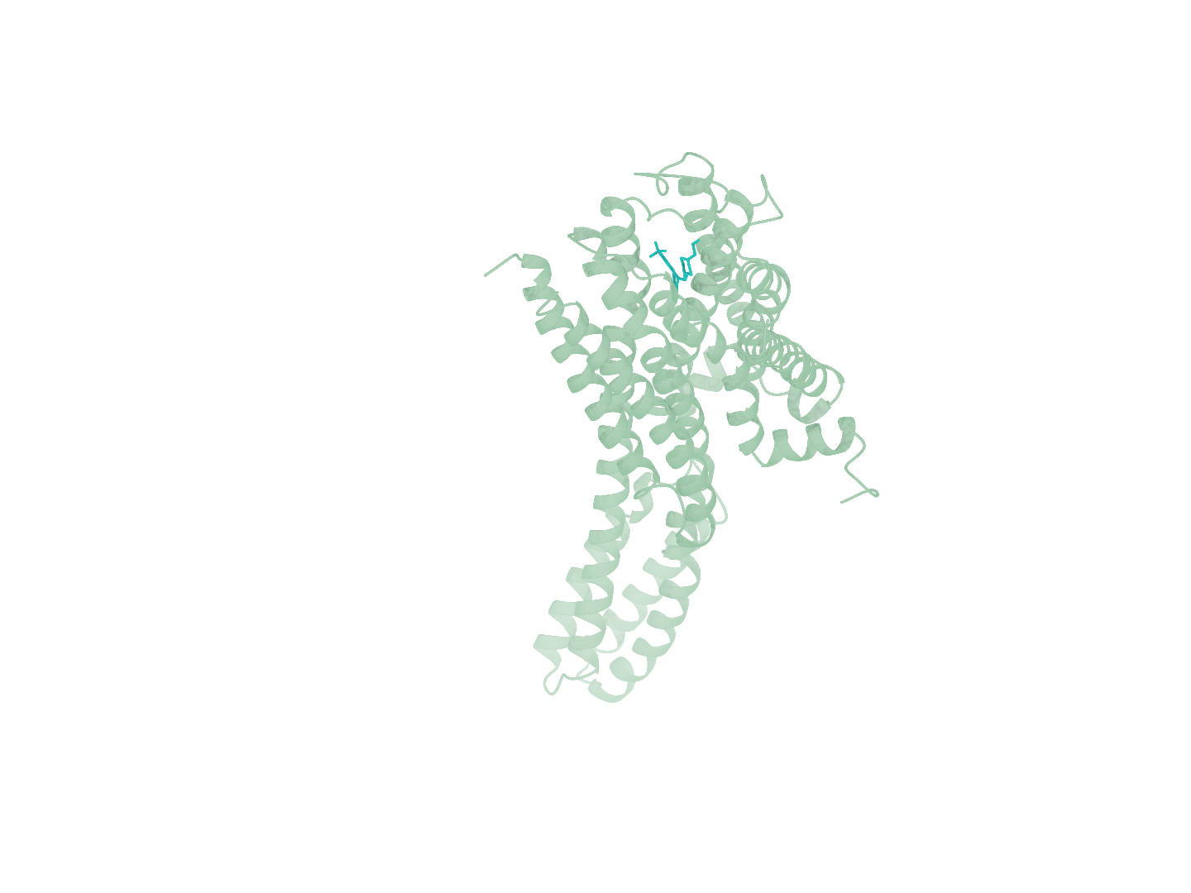
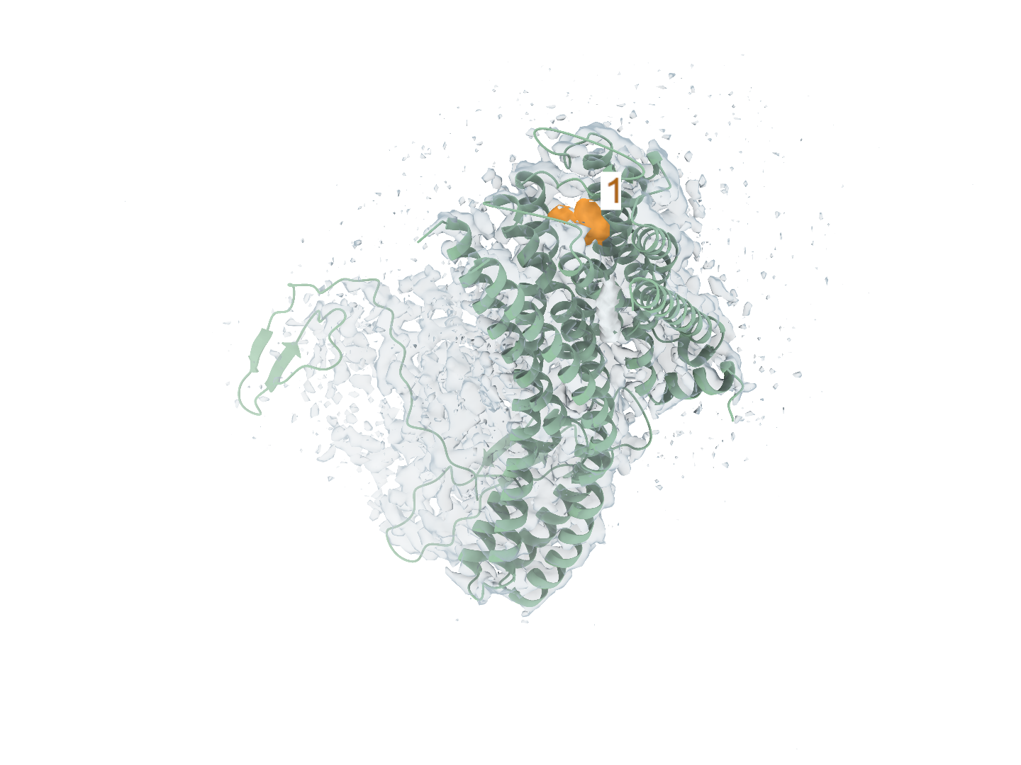
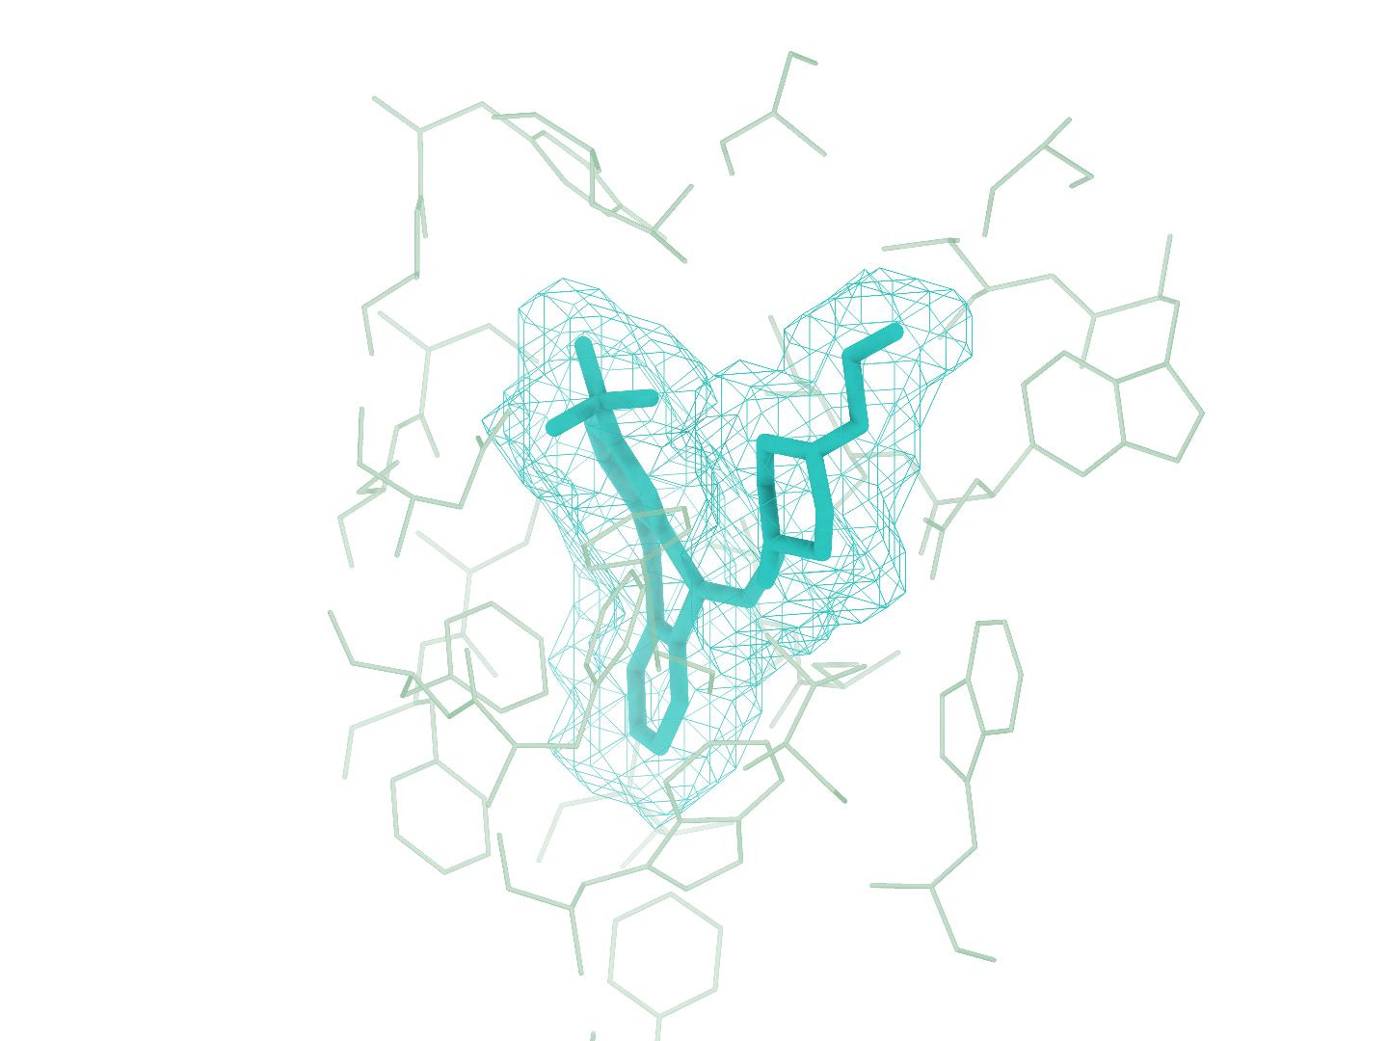
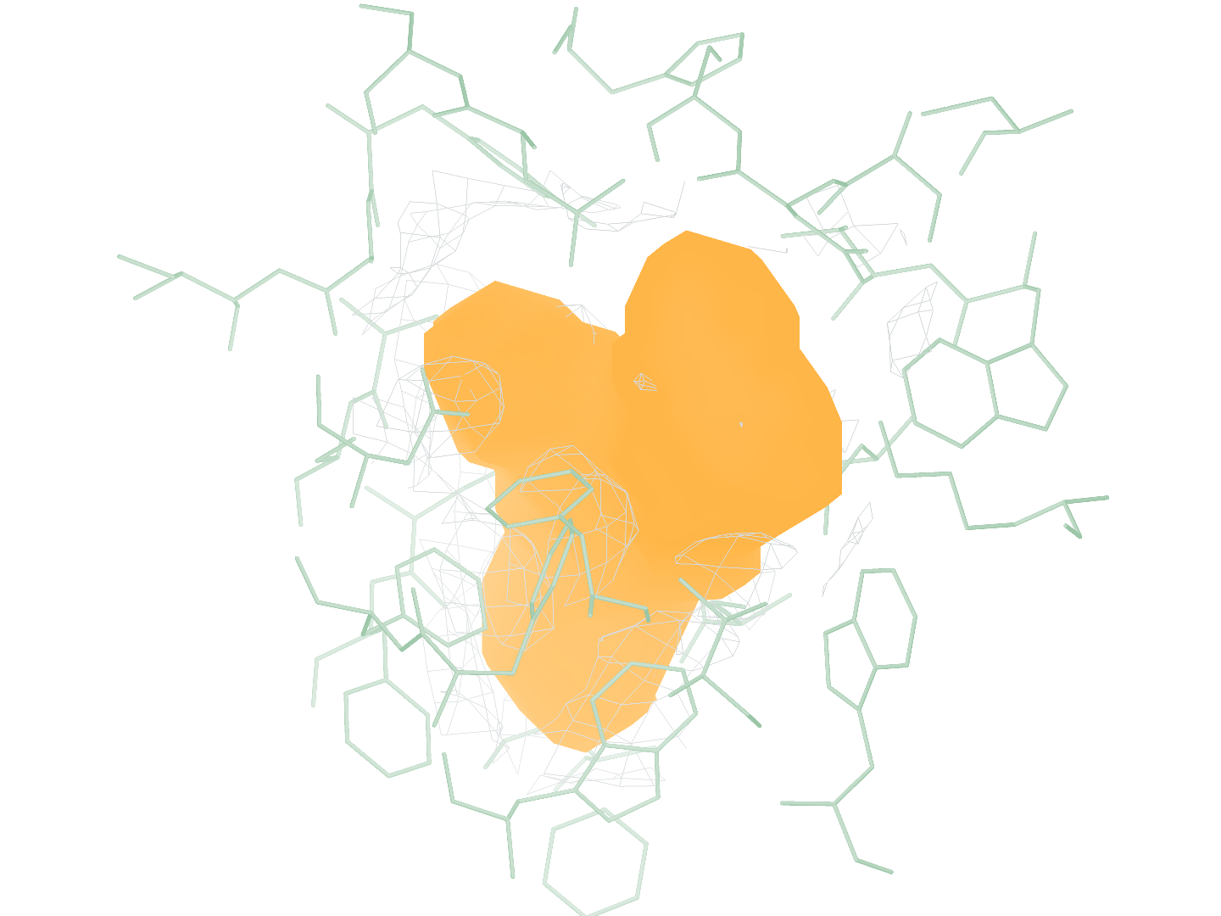
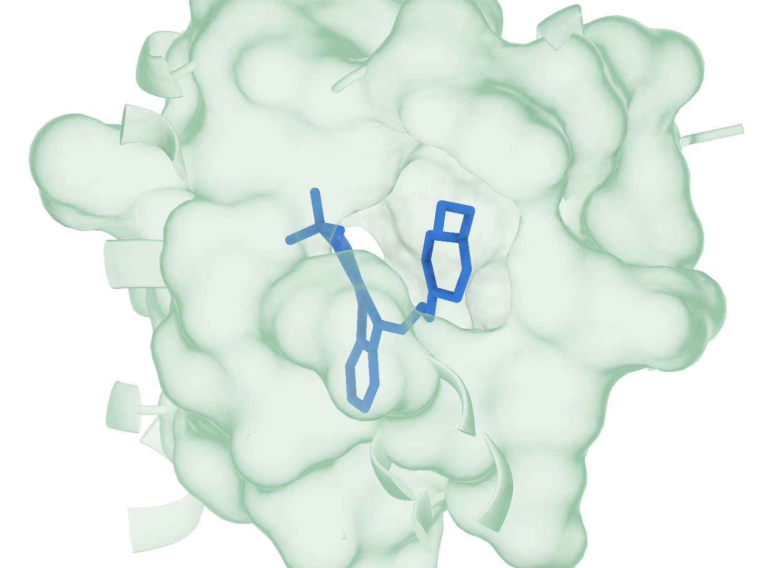
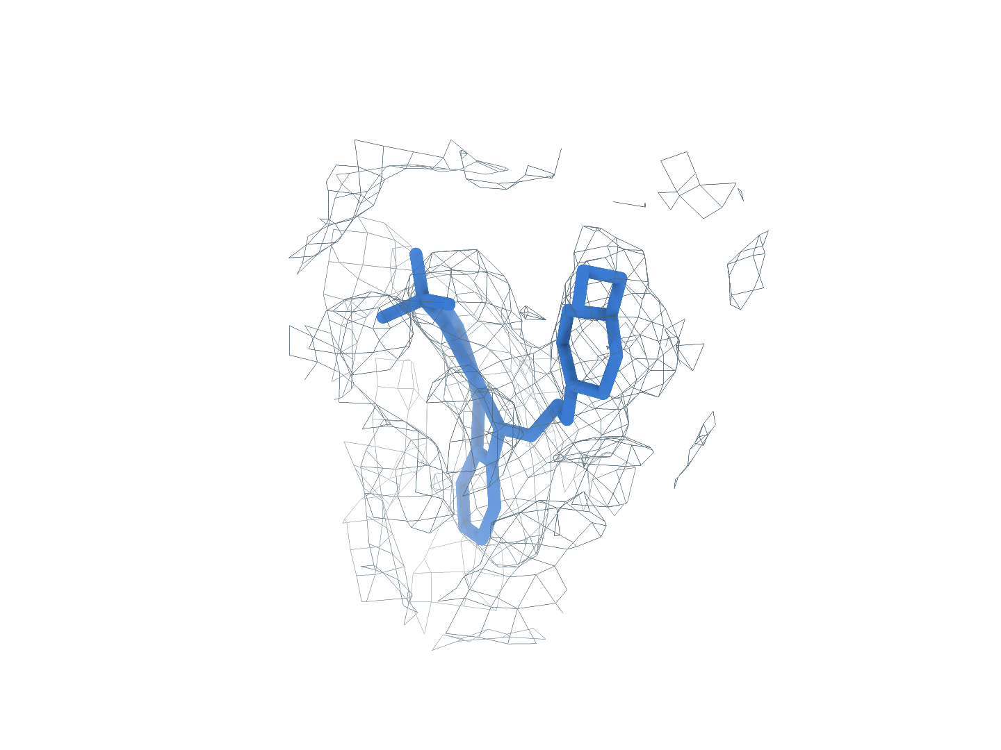
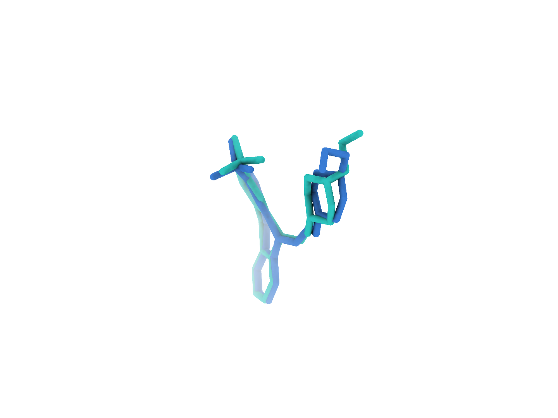
9LLG A1EKL (R:602)
The first-ranked site completes identity matching and pose reconstruction
0
Input
Experimental map and CA2 receptor
a
Full experimental map
b
Full CA2 receptor
c
GT receptor (reference)
1
Find
Ranked density regions, site 1 uses charged attempt 1
d
Global candidates
e
GT neighborhood
f
Find prediction
Rank 1: target ligand
All 3 predicted blobs
2
Match
RDKit structures of every supplied SMILES identity
g
1 Identity1
2 A1EKL
3 Identity3
Eligible small molecule
Matched identity
Eligible small molecule
3
Build
local_cov-C self-ranking Top-1, one pose in three views
h
Receptor surface
i
Experimental density
j
Deposited pose overlay
Heavy-atom RMSD 0.88 Å Clash 0 50 poses, 100 steps
Receptor
Density
Target blob
Predicted pose
Deposited pose
Notes:
图 14｜9LLG 的完整重建流程。首位 A1EKL(R:602) 依次完成区域检出、身份匹配和构象重建。 a–c，完整实验密度、CryoAtom2 受体及 GT 受体参考。d，全部 3 个预测 blob 的全局分布；e、f，GT 邻域与 Find 局部对照，每对朝向和尺度一致。g，原顺序的全部 3 个 SMILES 身份，3 个合格小分子参与匹配，蓝框标出精确匹配项。h–j，同一 local_cov-C 自评分首位姿态的受体、密度和沉积构象叠加视图，重原子 RMSD 0.88 Å。受体绿色，密度灰色，目标 blob 橙色，背景灰紫色，预测构象蓝色，沉积构象青绿色。所示目标位点生成 50 个姿态，每姿态 100 步采样；GT 仅供参考及最终评价。

Slide 4

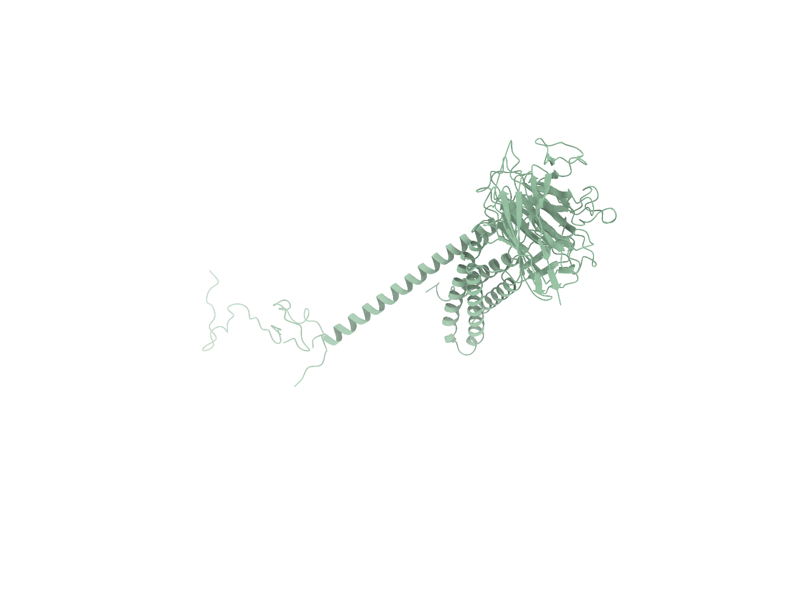
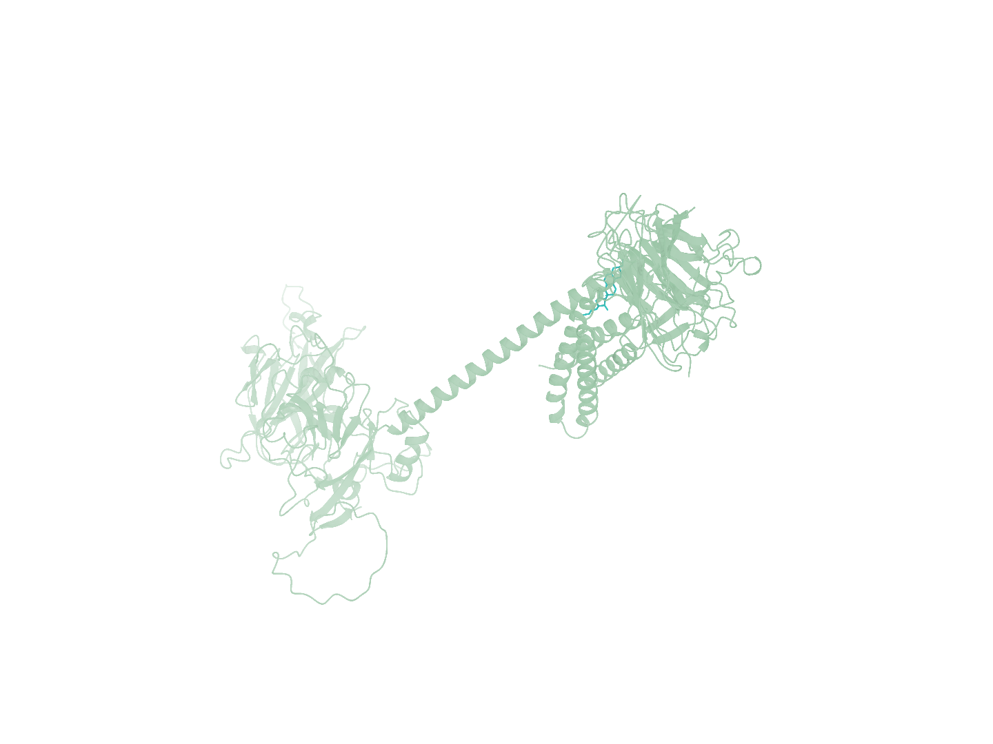
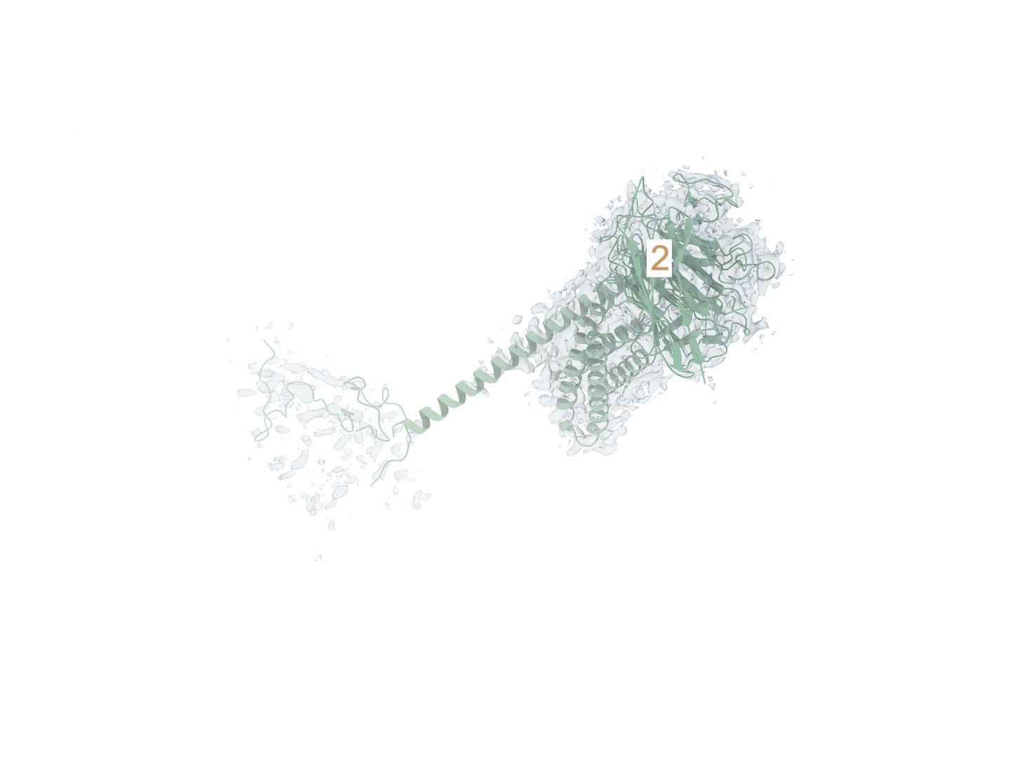
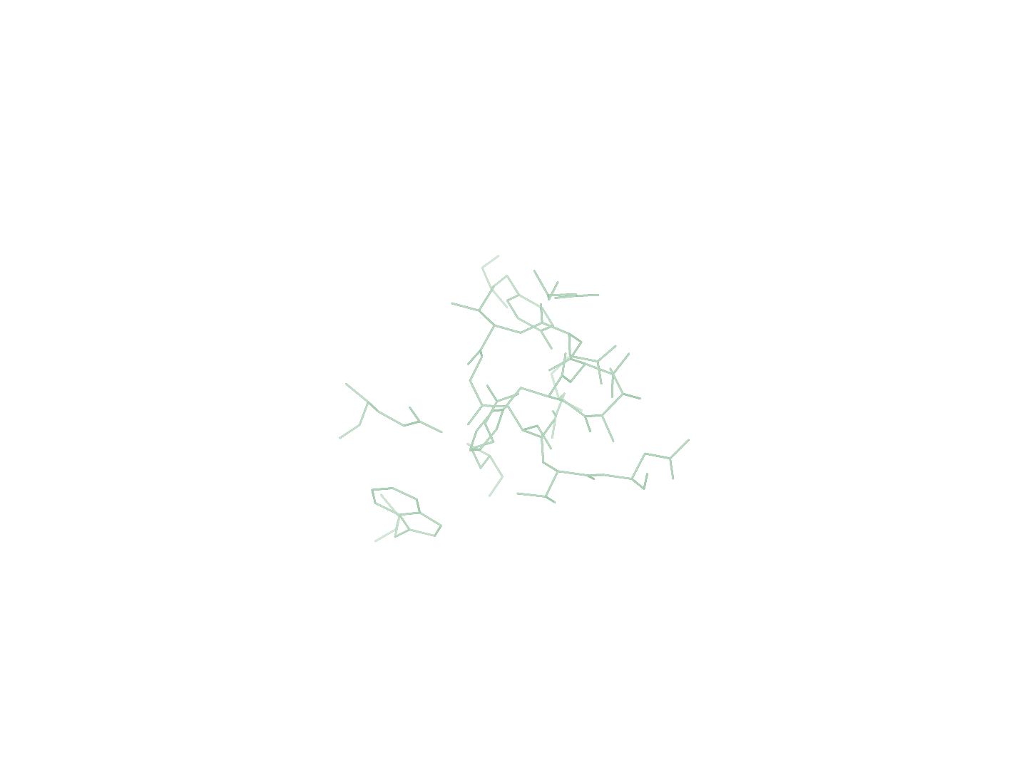
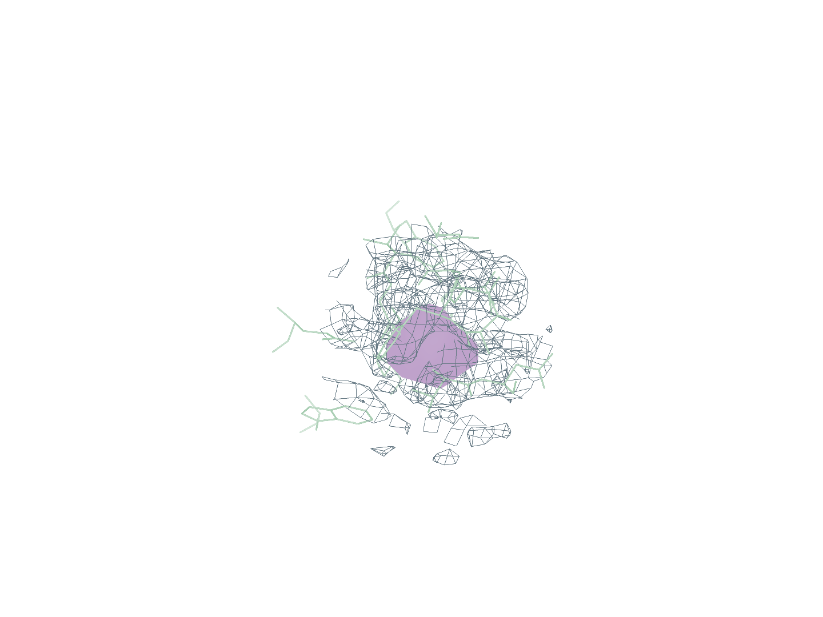
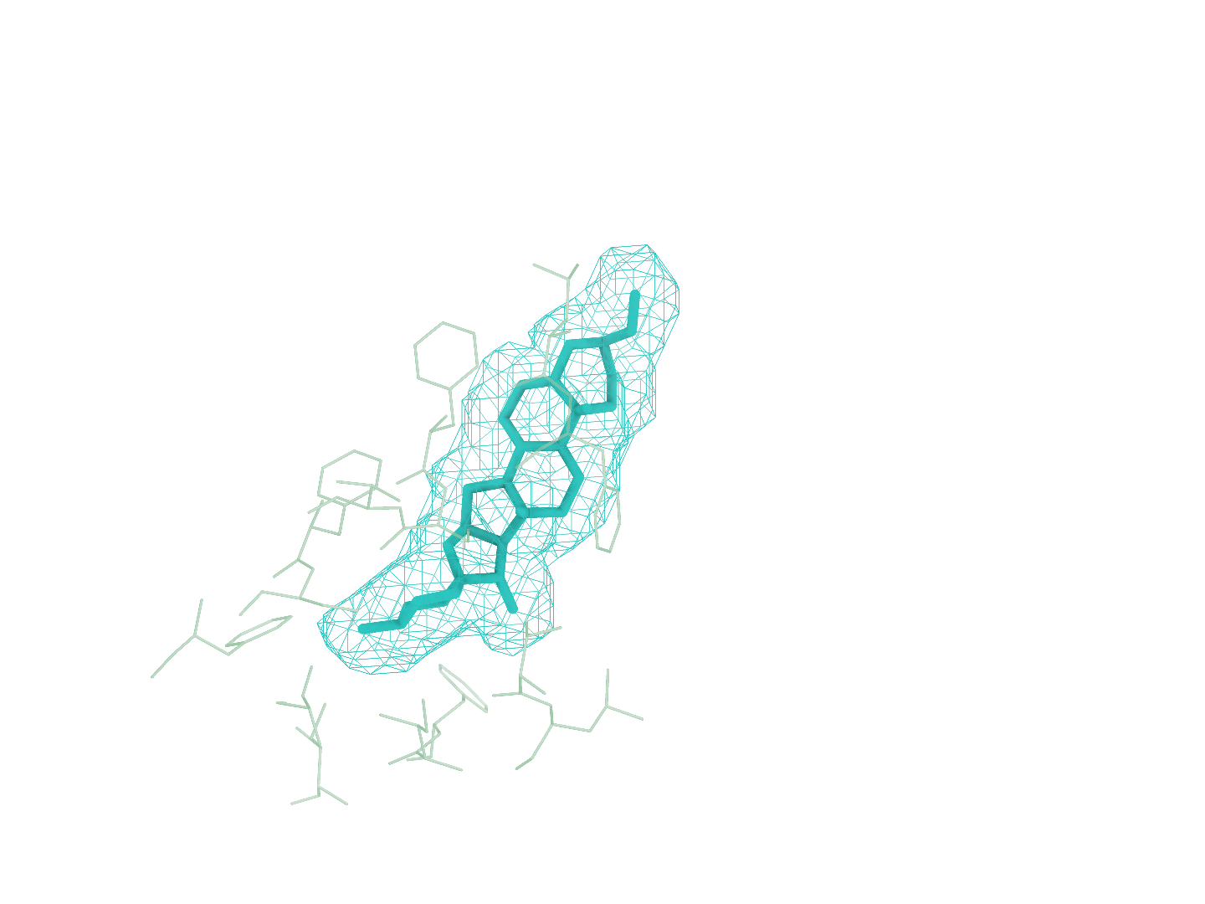
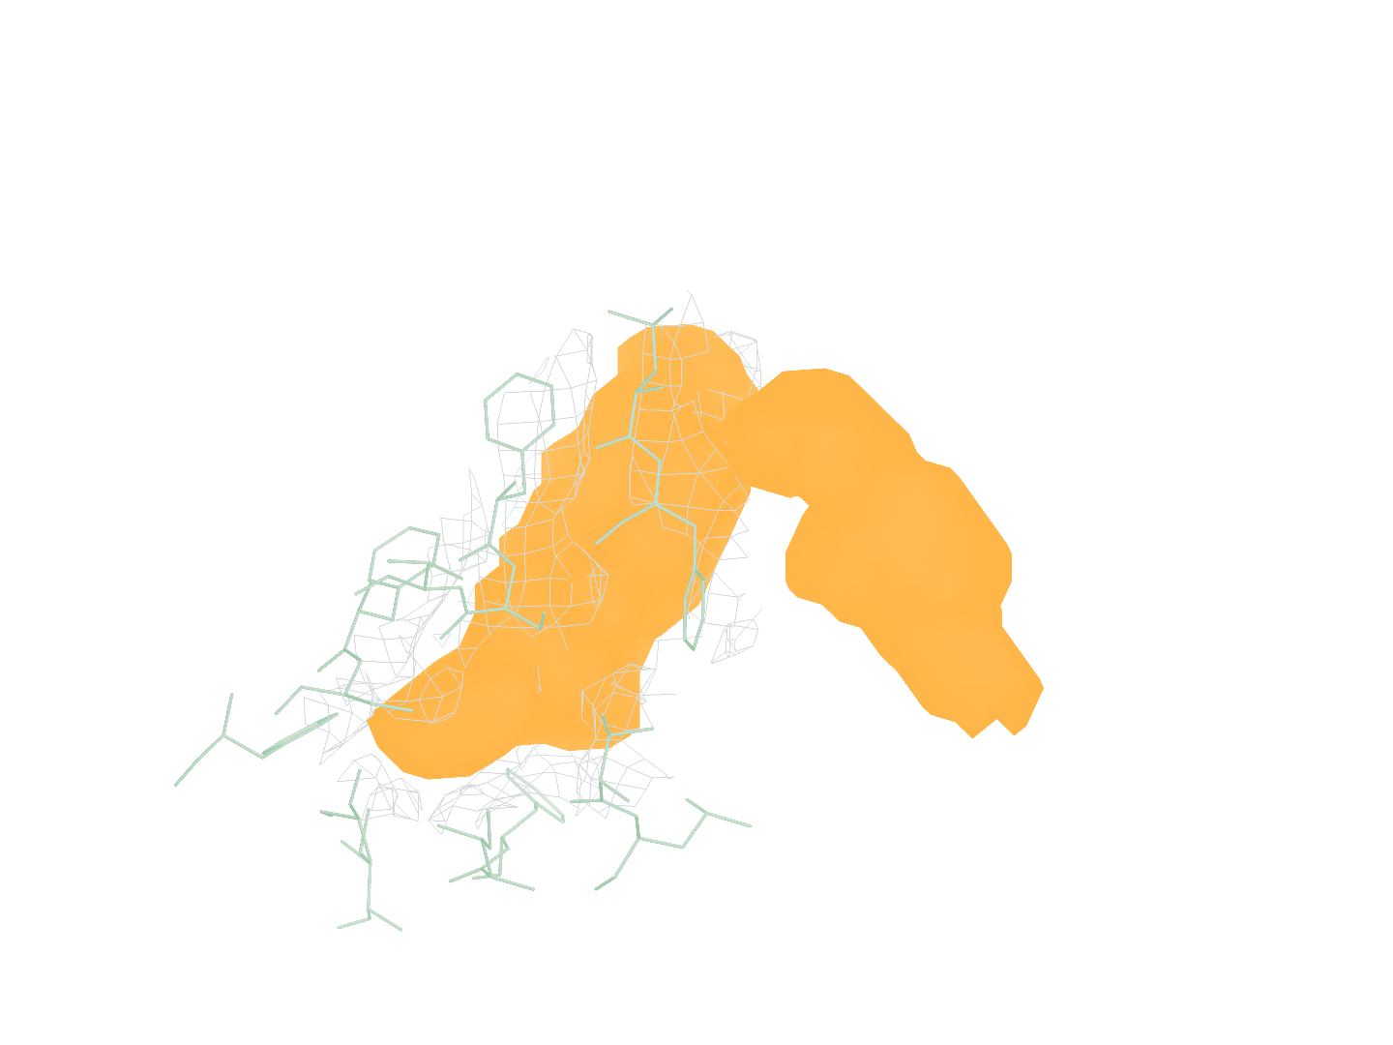
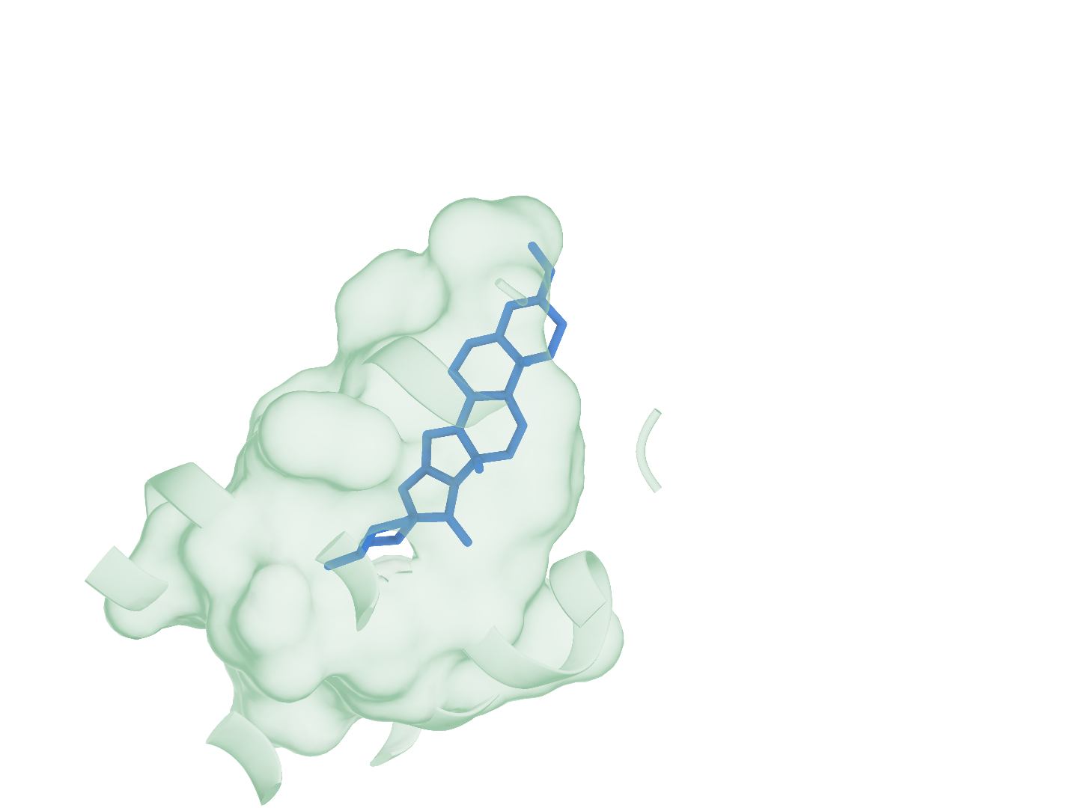
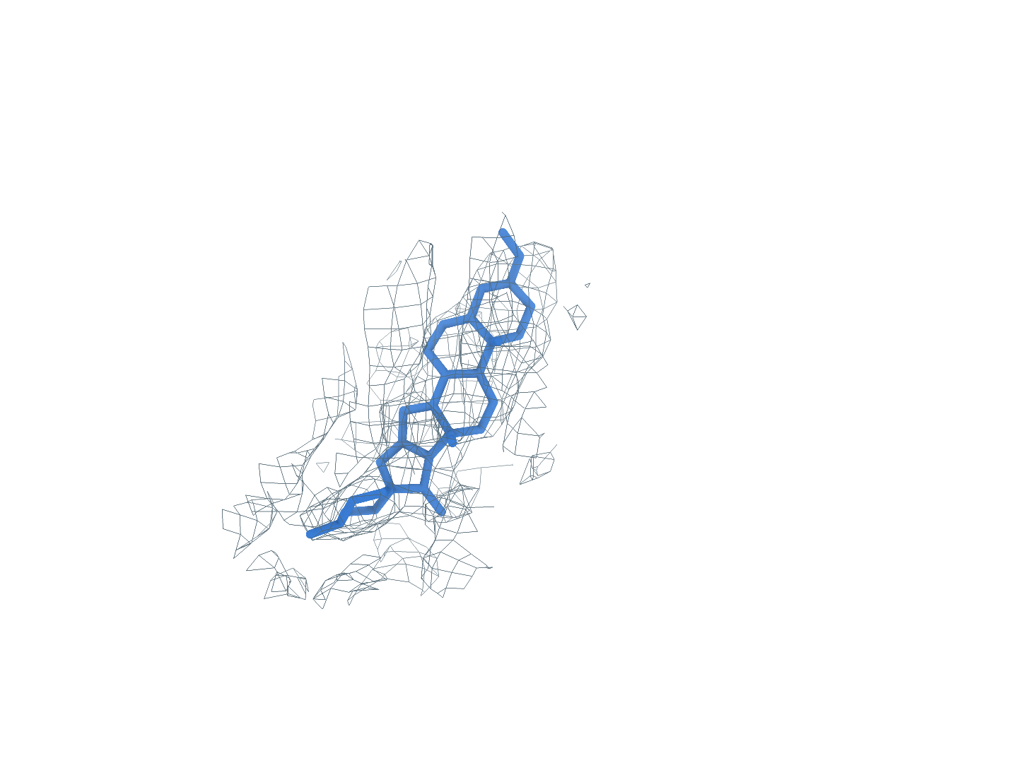
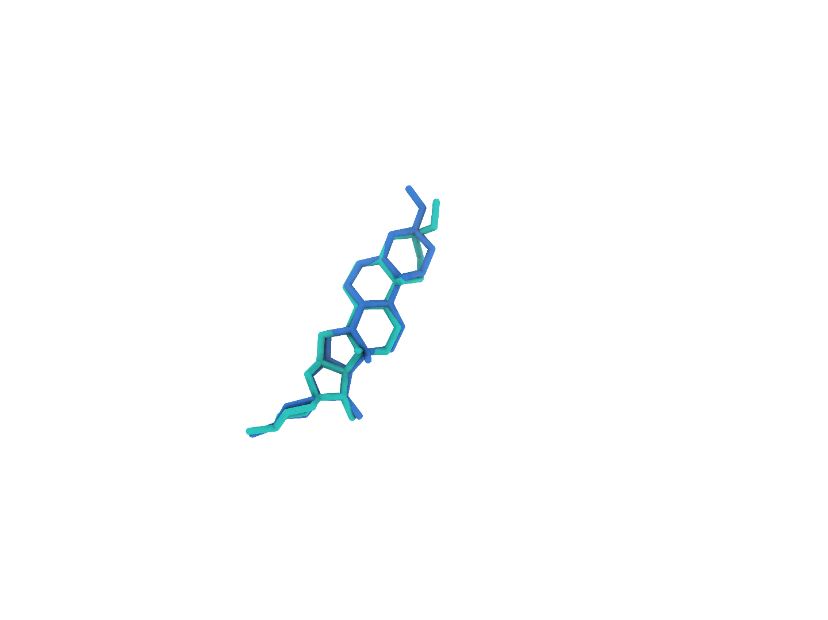
9QRU A1JAX (B:2801)
Background at rank 1, successful reconstruction at rank 2
0
Input
Experimental map and CA2 receptor
a
Full experimental map
b
Full CA2 receptor
c
GT receptor (reference)
1
Find
Ranked density regions, site 2 uses charged attempt 2
d
Global candidates
e
GT neighborhood
f
Find prediction
Rank 1: background, one attempt
Rank 2: target ligand, next attempt
All 4 predicted blobs
2
Match
RDKit structures of every supplied SMILES identity
g
1 A1JAX
2 Identity2
3 Identity3
Matched identity
Eligible small molecule
Outside Stage3 scope
3
Build
local_cov-C self-ranking Top-1, one pose in three views
h
Receptor surface
i
Experimental density
j
Deposited pose overlay
Heavy-atom RMSD 0.63 Å Clash 0 50 poses, 100 steps
Receptor
Density
Target blob
Predicted pose
Deposited pose
Notes:
图 15｜9QRU 的完整重建流程。首位背景消耗一次尝试，未进入 Match 或 Build；第二位 A1JAX(B:2801) 完成重建。 a–c，完整实验密度、CryoAtom2 受体及 GT 受体参考。d，全部 4 个预测 blob 的全局分布；e、f，GT 邻域与 Find 局部对照，每对朝向和尺度一致。g，原顺序的全部 3 个 SMILES 身份，2 个合格小分子参与匹配，蓝框标出精确匹配项。h–j，同一 local_cov-C 自评分首位姿态的受体、密度和沉积构象叠加视图，重原子 RMSD 0.63 Å。受体绿色，密度灰色，目标 blob 橙色，背景灰紫色，预测构象蓝色，沉积构象青绿色。所示目标位点生成 50 个姿态，每姿态 100 步采样；GT 仅供参考及最终评价。 该候选原入选标记为 false，仍按完整顺序评价。

Slide 5

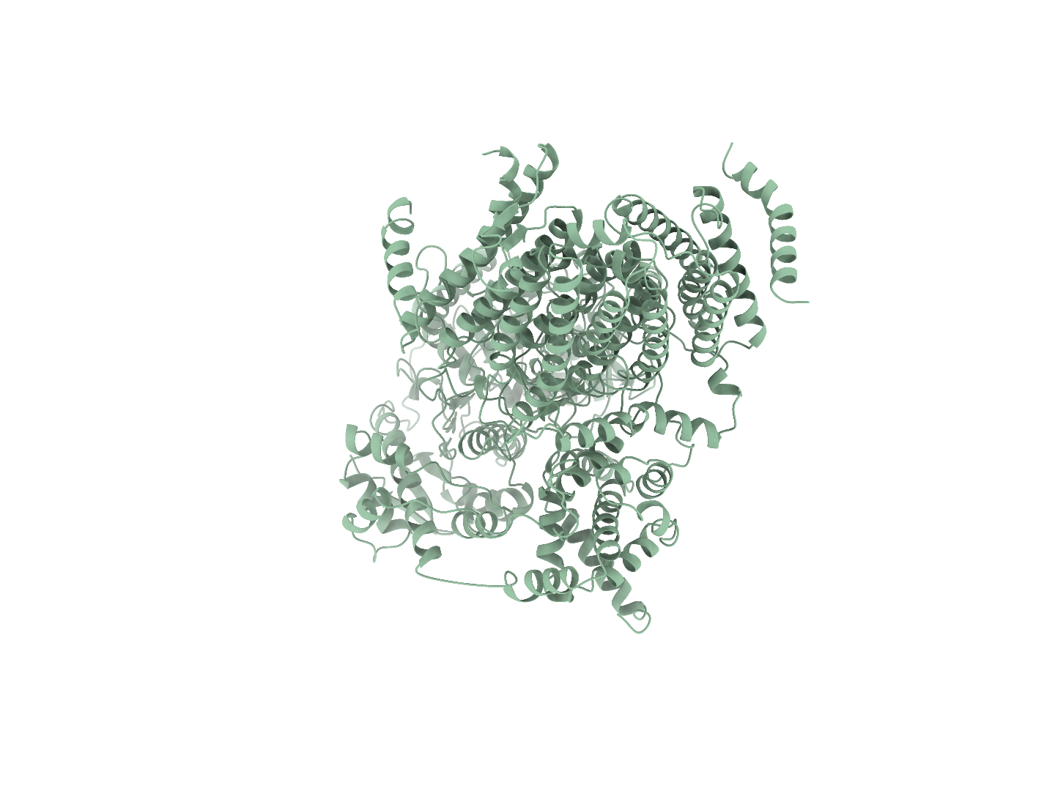
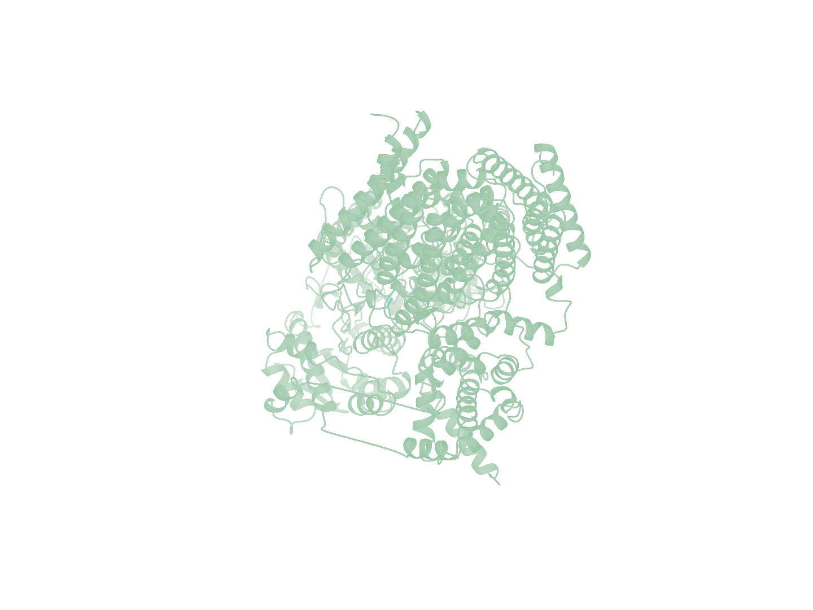
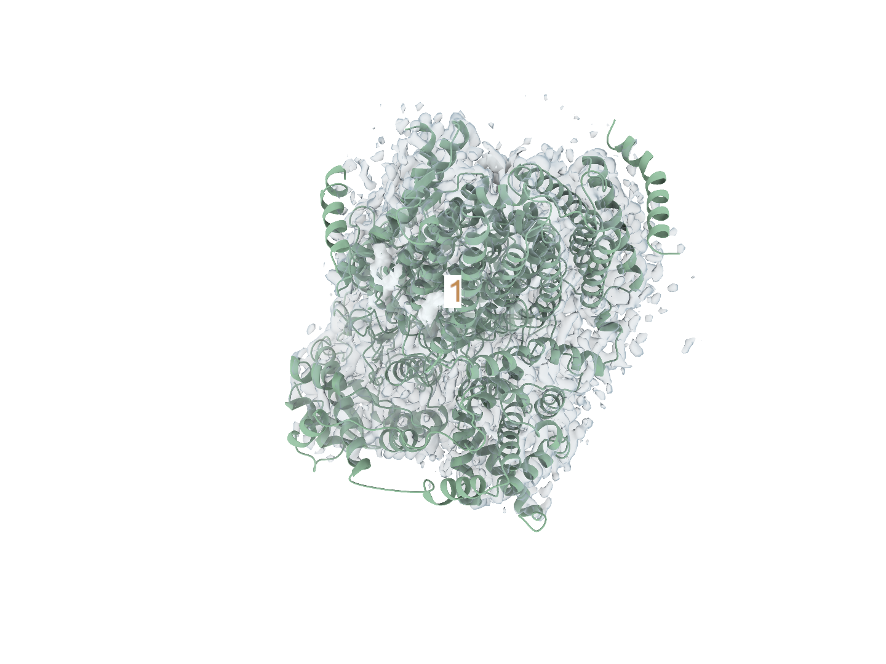
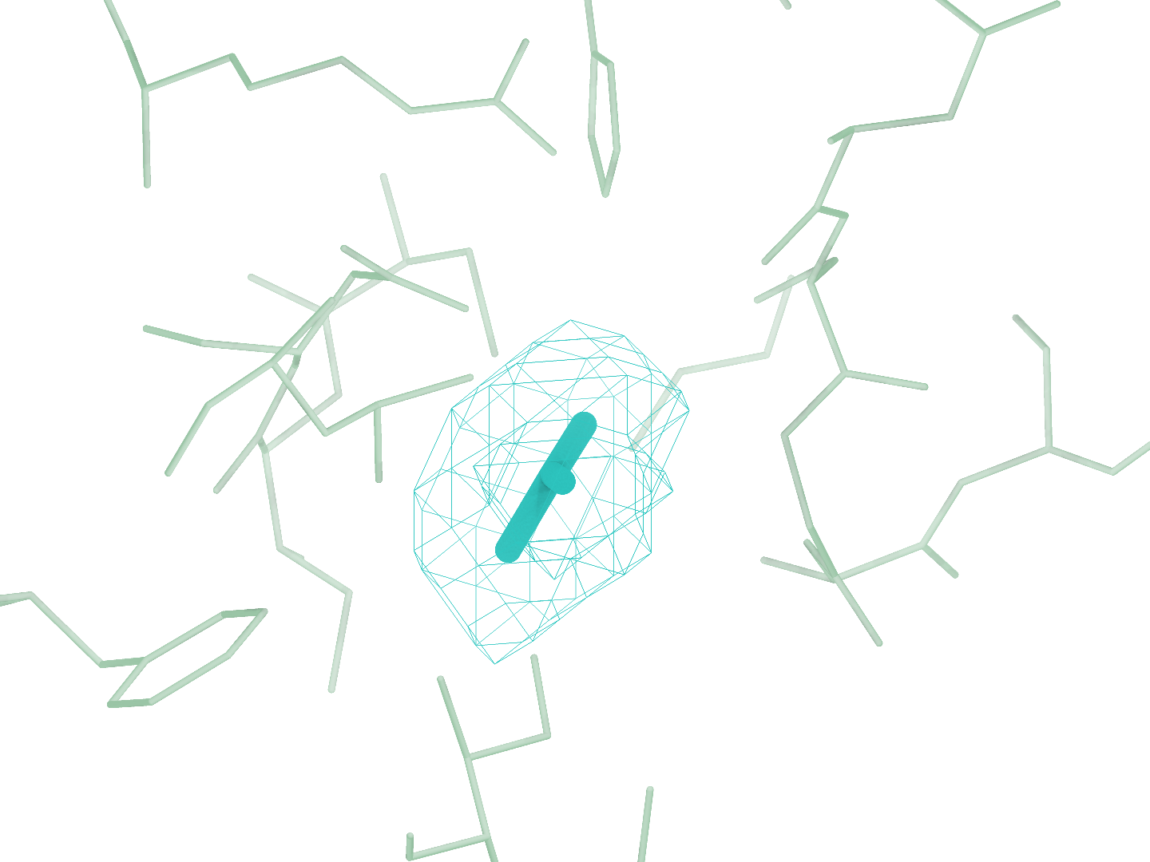
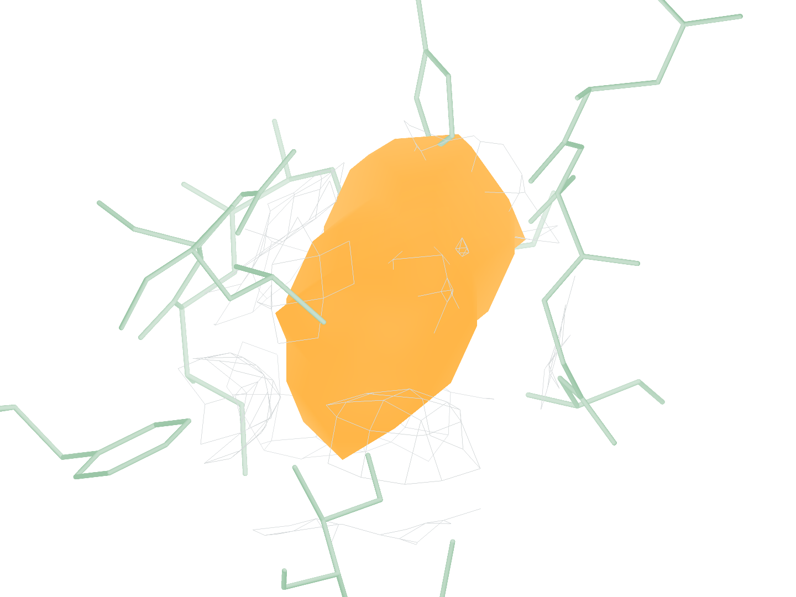
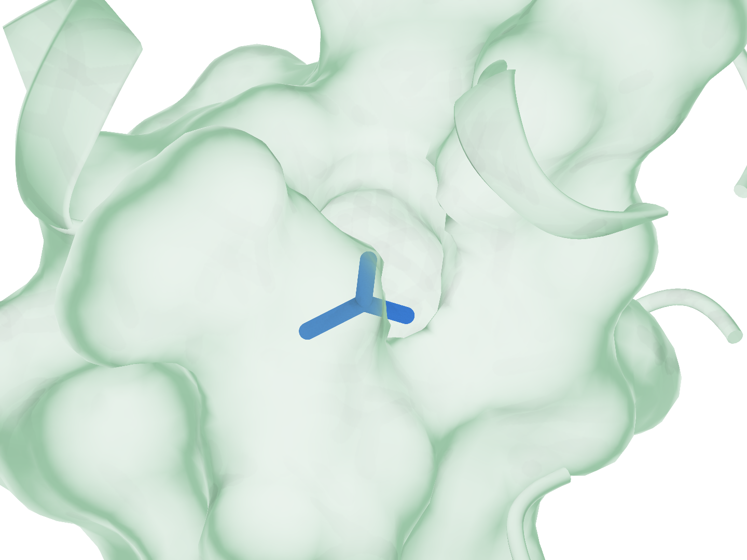
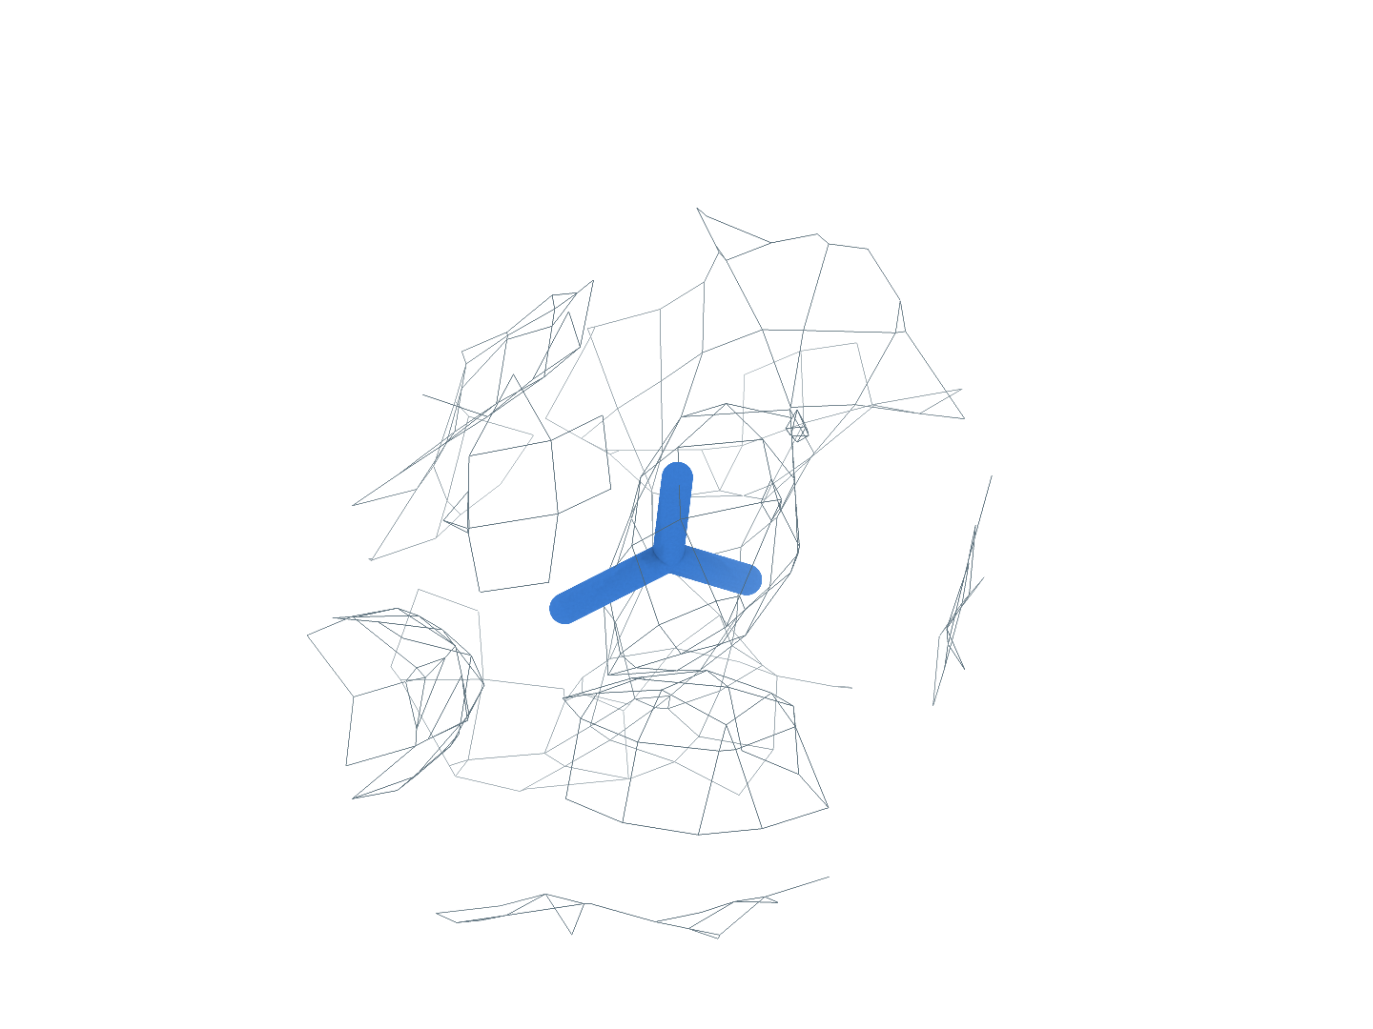

9RD8 BCT (A:902)
The first-ranked site completes identity matching and pose reconstruction
0
Input
Experimental map and CA2 receptor
a
Full experimental map
b
Full CA2 receptor
c
GT receptor (reference)
1
Find
Ranked density regions, site 1 uses charged attempt 1
d
Global candidates
e
GT neighborhood
f
Find prediction
Rank 1: target ligand
All 5 predicted blobs
2
Match
RDKit structures of every supplied SMILES identity
g
1 Identity1
2 BCT
3 Identity3
4 Identity4
Eligible small molecule
Matched identity
Eligible small molecule
Outside Stage3 scope
3
Build
local_cov-C self-ranking Top-1, one pose in three views
h
Receptor surface
i
Experimental density
j
Deposited pose overlay
Heavy-atom RMSD 0.96 Å Clash 0 50 poses, 100 steps
Receptor
Density
Target blob
Predicted pose
Deposited pose
Notes:
备选图｜9RD8 的完整重建流程。首位 BCT(A:902) 依次完成区域检出、身份匹配和构象重建。 a–c，完整实验密度、CryoAtom2 受体及 GT 受体参考。d，全部 5 个预测 blob 的全局分布；e、f，GT 邻域与 Find 局部对照，每对朝向和尺度一致。g，原顺序的全部 4 个 SMILES 身份，3 个合格小分子参与匹配，蓝框标出精确匹配项。h–j，同一 local_cov-C 自评分首位姿态的受体、密度和沉积构象叠加视图，重原子 RMSD 0.96 Å。受体绿色，密度灰色，目标 blob 橙色，背景灰紫色，预测构象蓝色，沉积构象青绿色。所示目标位点生成 50 个姿态，每姿态 100 步采样；GT 仅供参考及最终评价。

Slide 6
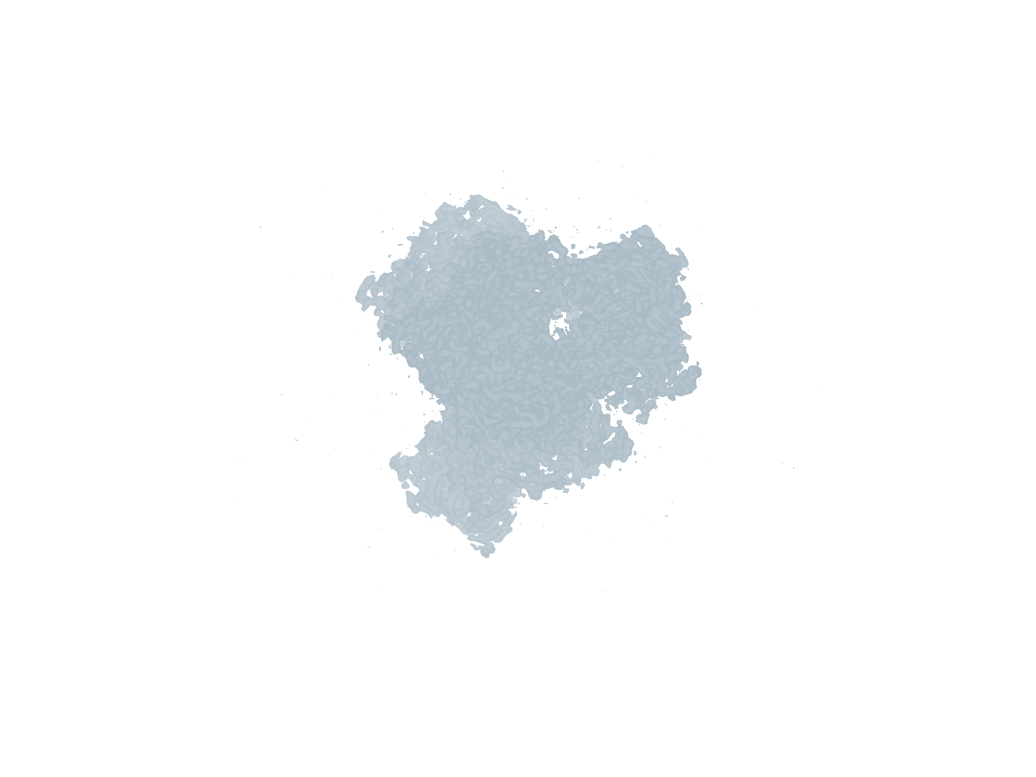
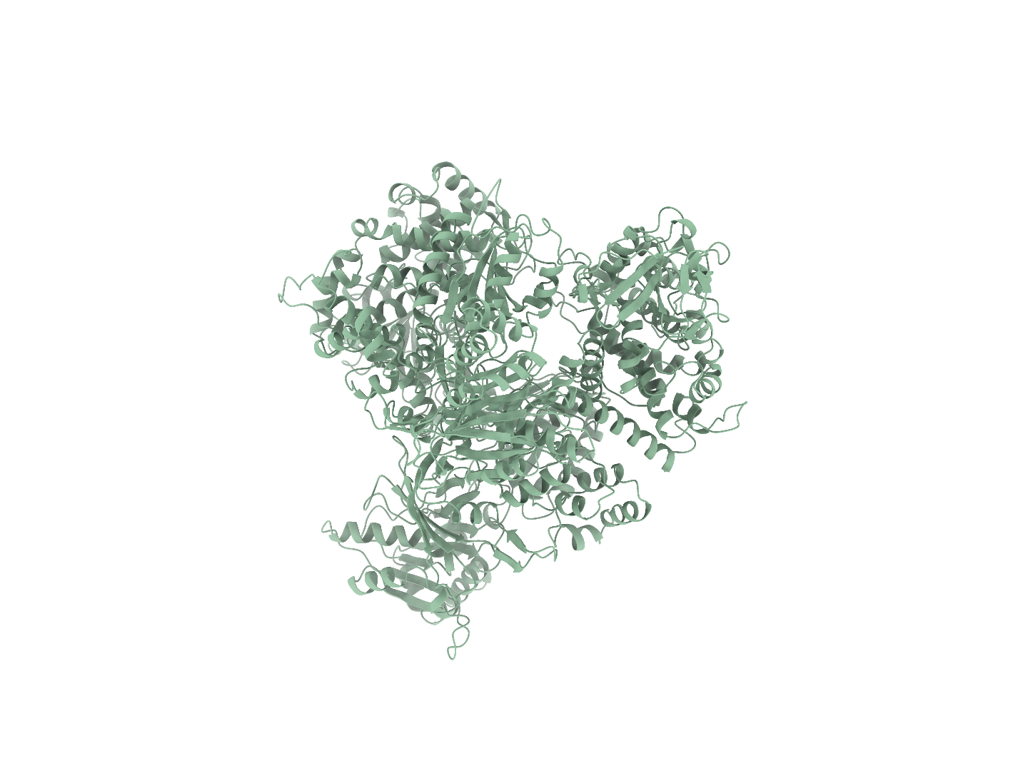
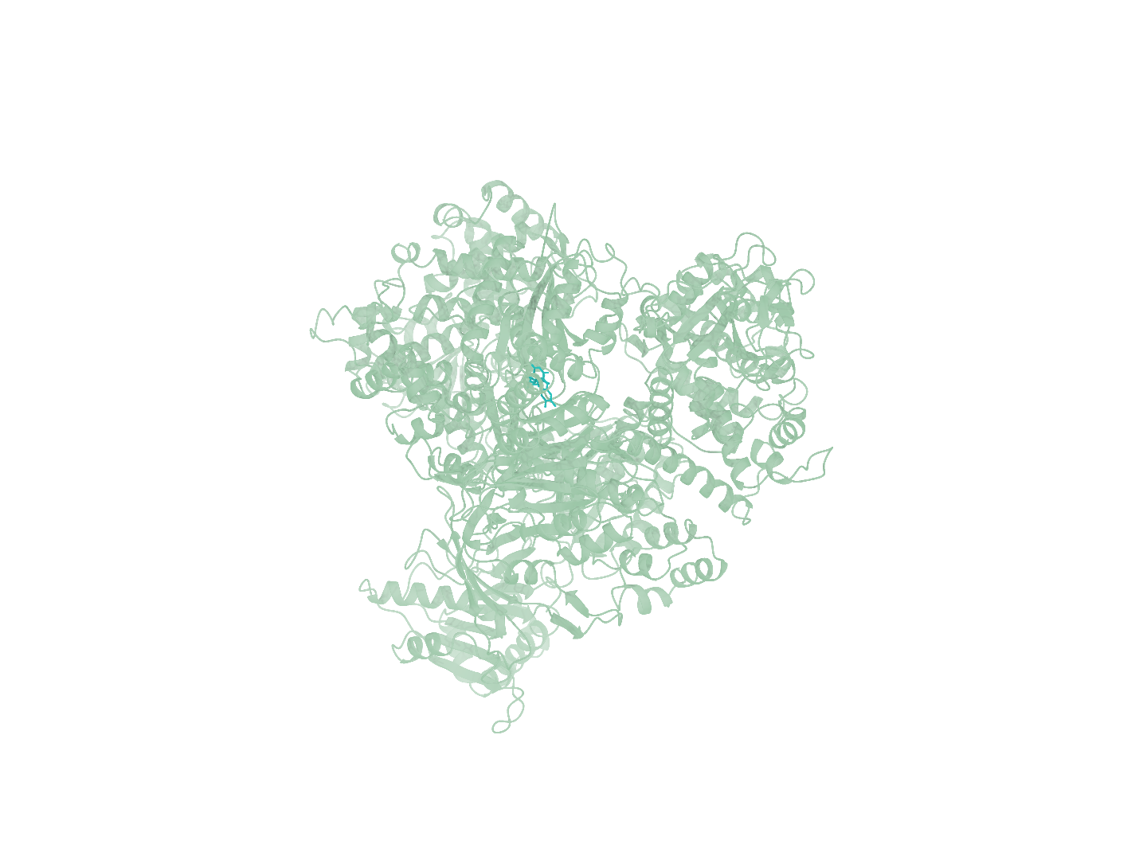
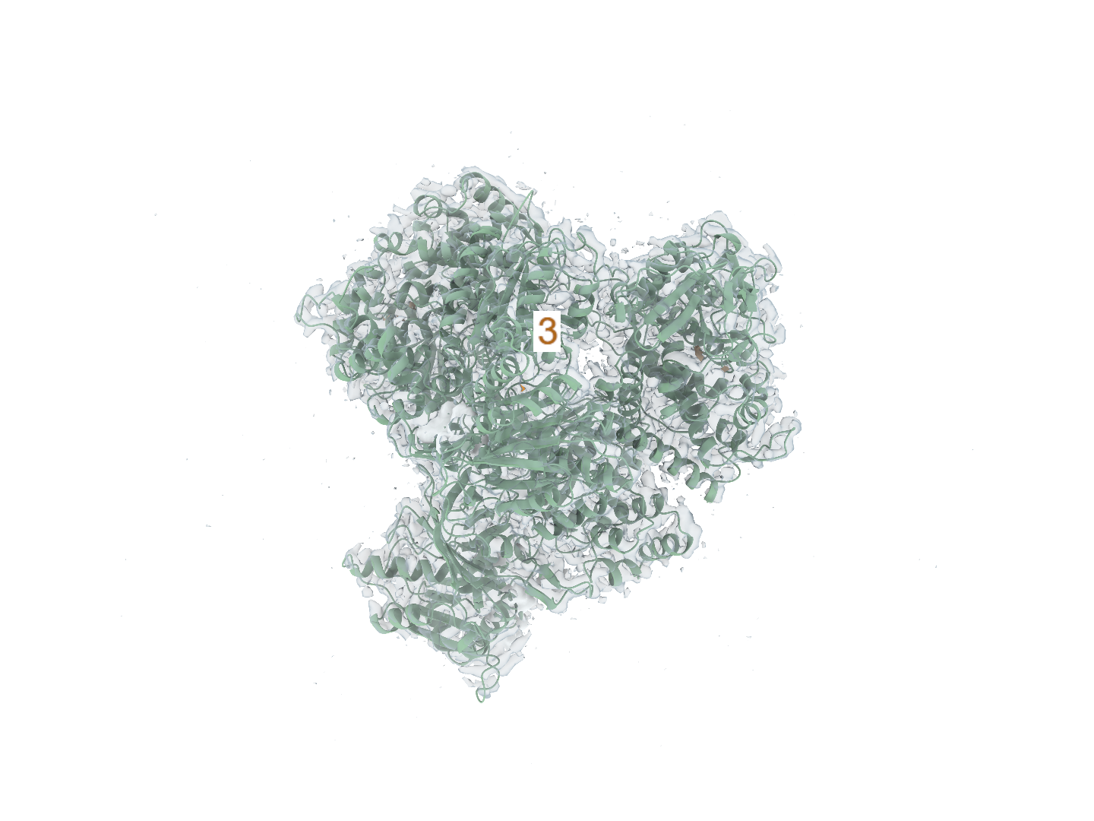
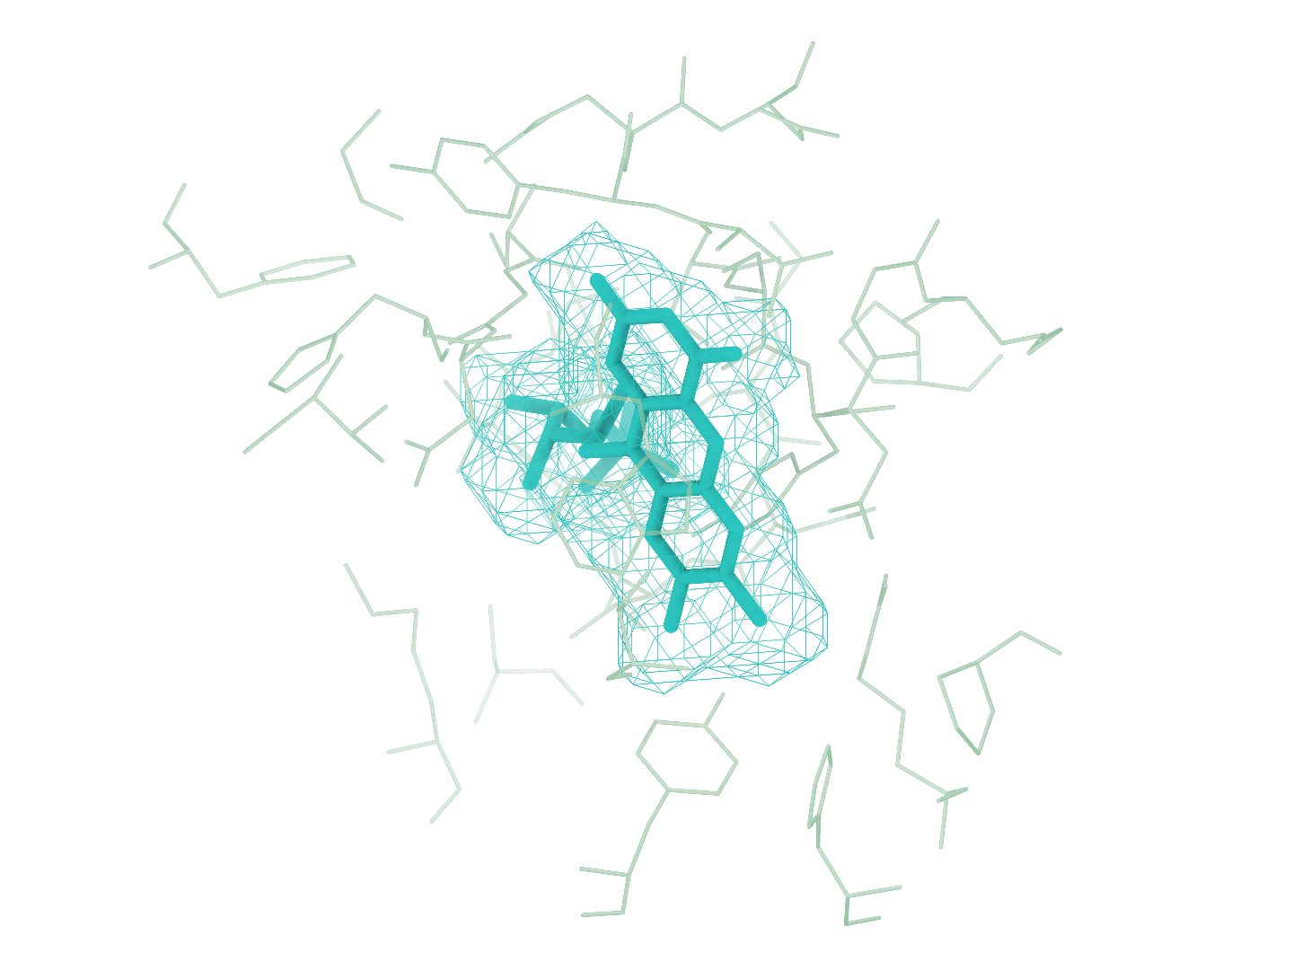
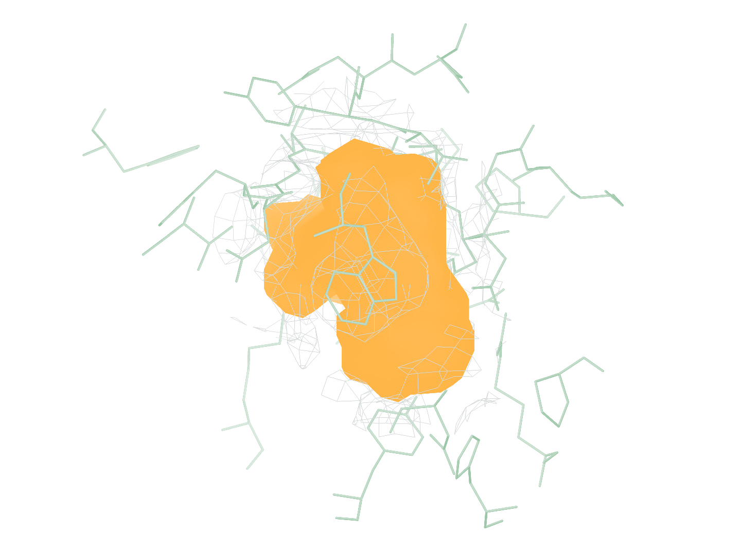



9WUP FMN (B:1103)
Earlier foreground outside Stage3 scope, successful reconstruction at rank 3
0
Input
Experimental map and CA2 receptor
a
Full experimental map
b
Full CA2 receptor
c
GT receptor (reference)
1
Find
Ranked density regions, site 3 uses charged attempt 1
d
Global candidates
e
GT neighborhood
f
Find prediction
Rank 3: target ligand
All 7 predicted blobs
Ranks 1–2: free scope skips
2
Match
RDKit structures of every supplied SMILES identity
g
1 HEM
2 Identity2
3 FMN
4 Identity4
Eligible small molecule
Eligible small molecule
Matched identity
Eligible small molecule
3
Build
local_cov-C self-ranking Top-1, one pose in three views
h
Receptor surface
i
Experimental density
j
Deposited pose overlay
Heavy-atom RMSD 0.52 Å Clash 0 50 poses, 100 steps
Receptor
Density
Target blob
Predicted pose
Deposited pose
Notes:
备选图｜9WUP 的完整重建流程。前 2 位前景经 Stage3 范围门禁免费跳过，第 3 位 FMN(B:1103) 为首个计费候选。 a–c，完整实验密度、CryoAtom2 受体及 GT 受体参考。d，全部 7 个预测 blob 的全局分布；e、f，GT 邻域与 Find 局部对照，每对朝向和尺度一致。g，原顺序的全部 4 个 SMILES 身份，4 个合格小分子参与匹配，蓝框标出精确匹配项。h–j，同一 local_cov-C 自评分首位姿态的受体、密度和沉积构象叠加视图，重原子 RMSD 0.52 Å。受体绿色，密度灰色，目标 blob 橙色，背景灰紫色，预测构象蓝色，沉积构象青绿色。所示目标位点生成 50 个姿态，每姿态 100 步采样；GT 仅供参考及最终评价。

Slide 7









9XZL AGS (F:1001)
Earlier foreground outside Stage3 scope, successful reconstruction at rank 2
0
Input
Experimental map and CA2 receptor
a
Full experimental map
b
Full CA2 receptor
c
GT receptor (reference)
1
Find
Ranked density regions, site 2 uses charged attempt 1
d
Global candidates
e
GT neighborhood
f
Find prediction
Rank 2: target ligand
All 3 predicted blobs
Rank 1: free scope skip
2
Match
RDKit structures of every supplied SMILES identity
g
1 AGS
2 Identity2
3 ZN
Matched identity
Outside Stage3 scope
Outside Stage3 scope
3
Build
local_cov-C self-ranking Top-1, one pose in three views
h
Receptor surface
i
Experimental density
j
Deposited pose overlay
Heavy-atom RMSD 0.91 Å Clash 0 50 poses, 100 steps
Receptor
Density
Target blob
Predicted pose
Deposited pose
Notes:
备选图｜9XZL 的完整重建流程。前 1 位前景经 Stage3 范围门禁免费跳过，第 2 位 AGS(F:1001) 为首个计费候选。 a–c，完整实验密度、CryoAtom2 受体及 GT 受体参考。d，全部 3 个预测 blob 的全局分布；e、f，GT 邻域与 Find 局部对照，每对朝向和尺度一致。g，原顺序的全部 3 个 SMILES 身份，1 个合格小分子参与匹配，蓝框标出精确匹配项。h–j，同一 local_cov-C 自评分首位姿态的受体、密度和沉积构象叠加视图，重原子 RMSD 0.91 Å。受体绿色，密度灰色，目标 blob 橙色，背景灰紫色，预测构象蓝色，沉积构象青绿色。所示目标位点生成 50 个姿态，每姿态 100 步采样；GT 仅供参考及最终评价。

